Slide 1
SR-TEEM-004
Taking a Step Towards Solving the Foot Crisis:
Reducing Joint Impact with Magnetic Levitation

Slide 2
Engineering Goal
Problem:
To create a cheap, soft, thin, and light shoe sole using magnetic levitation without excess weight and with greater compression.
Rationale/Need:
Current shoe technology has reached its maximum, as there’s only so much that foam can do. I decided to do this project after my mom had recently been diagnosed with Plantar Fasciitis. It is my hope that this project can provide hope to those in constant pain, as well as the human population in general. This project will combat the problem of foot pain.
Testing and Constraints:
Constraints include a budget of $20, 453.5 g of total weight, and access to regular machines available in a common workshop.
These constraints ensure that the shoe remains practical enough for everyday wearing. The budget makes sure that the shoe won't cost too much more and the weight limits the amount of extra weight that can be added on, which could greatly reduce the practicality.
And Rationale

Slide 3
Solution
The proposed method is a Halbach Array based magnetic levitation system embedded in the sole of the shoe to reduce the impact force of the footstep, which therefore reduces the force exerted on joints as well. By using magnetic levitation, the force is spread out across the fields which absorb the impact shock of the footstep much better than foam could. Because magnets push more when they have more force on them, they can adapt to the situation they are put under, not to mention the greater durability when compared to current shoes. This makes it many times more practical than the previous shoe.

Slide 4
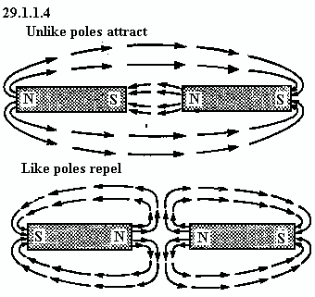
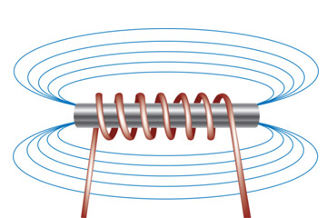
Research and Concept Review
Magnetic Principles
Law of Magnetism: Opposite poles attract each other and similar poles repel
Basis of magnetic suspension: repulsive properties
Magnetic Repulsion will provide a contactless suspended feeling for less impact, and therefore less shoe midsole compression
Magnets exert exponentially increasing force as force is applied to them
Electromagnets: A magnet formation that reduces flux across one face and moves it to the other face
An alternative way to lift the entire force of a person with a few magnets
Allows for a dynamic adjustment of force provided
Idea dropped due to too much extra weight and not enough space
http://www.lewpaxtonprice.us/magnet.htm
Figure 1: Visual of Magnetic Laws
https://www.magnet-sdm.com/2018/10/30/halbach-array/https://science.howstuffworks.com/electromagnet3.htm
Figure 2: Electromagnetic Flux Field

Slide 5
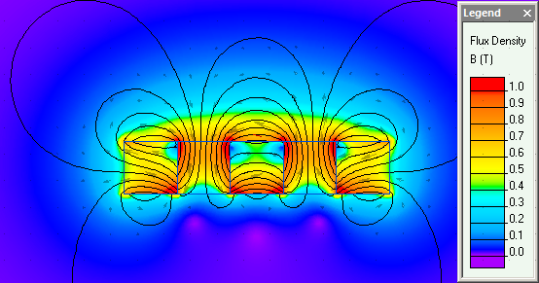
Halbach Arrays
Advantages
The most obvious benefit of a Halbach-style Array is that the field produced is very strong when compared to other arrays having the same amount of the magnet alloy. The arrangement essentially increases the efficiency of the magnetic circuit.
The by-product of the design is that there is only one working surface or “working face.” The one working-face, where the magnetic field resides, is very strong; and the non-working face has essentially no field. In essence, the magnetic field, which would normally be present on the non-working face, is rerouted to the working-face.
Disadvantages
The primary disadvantage of the Halbach Array geometry is that it is difficult
to put together, resulting in potentially higher manufacturing costs than other
potential solutions. This is because all of the magnet elements are repelling
each other in a Halbach Array. This can create a variety of assembly issues
like ensuring that the assembly will “hold together” during its use.
Figure 3: Halbach Array Arrangement
https://quickfield.com/advanced/halbach_array.htm
Figure 4: Magnetic Flux in Halbach Arrays

Slide 6
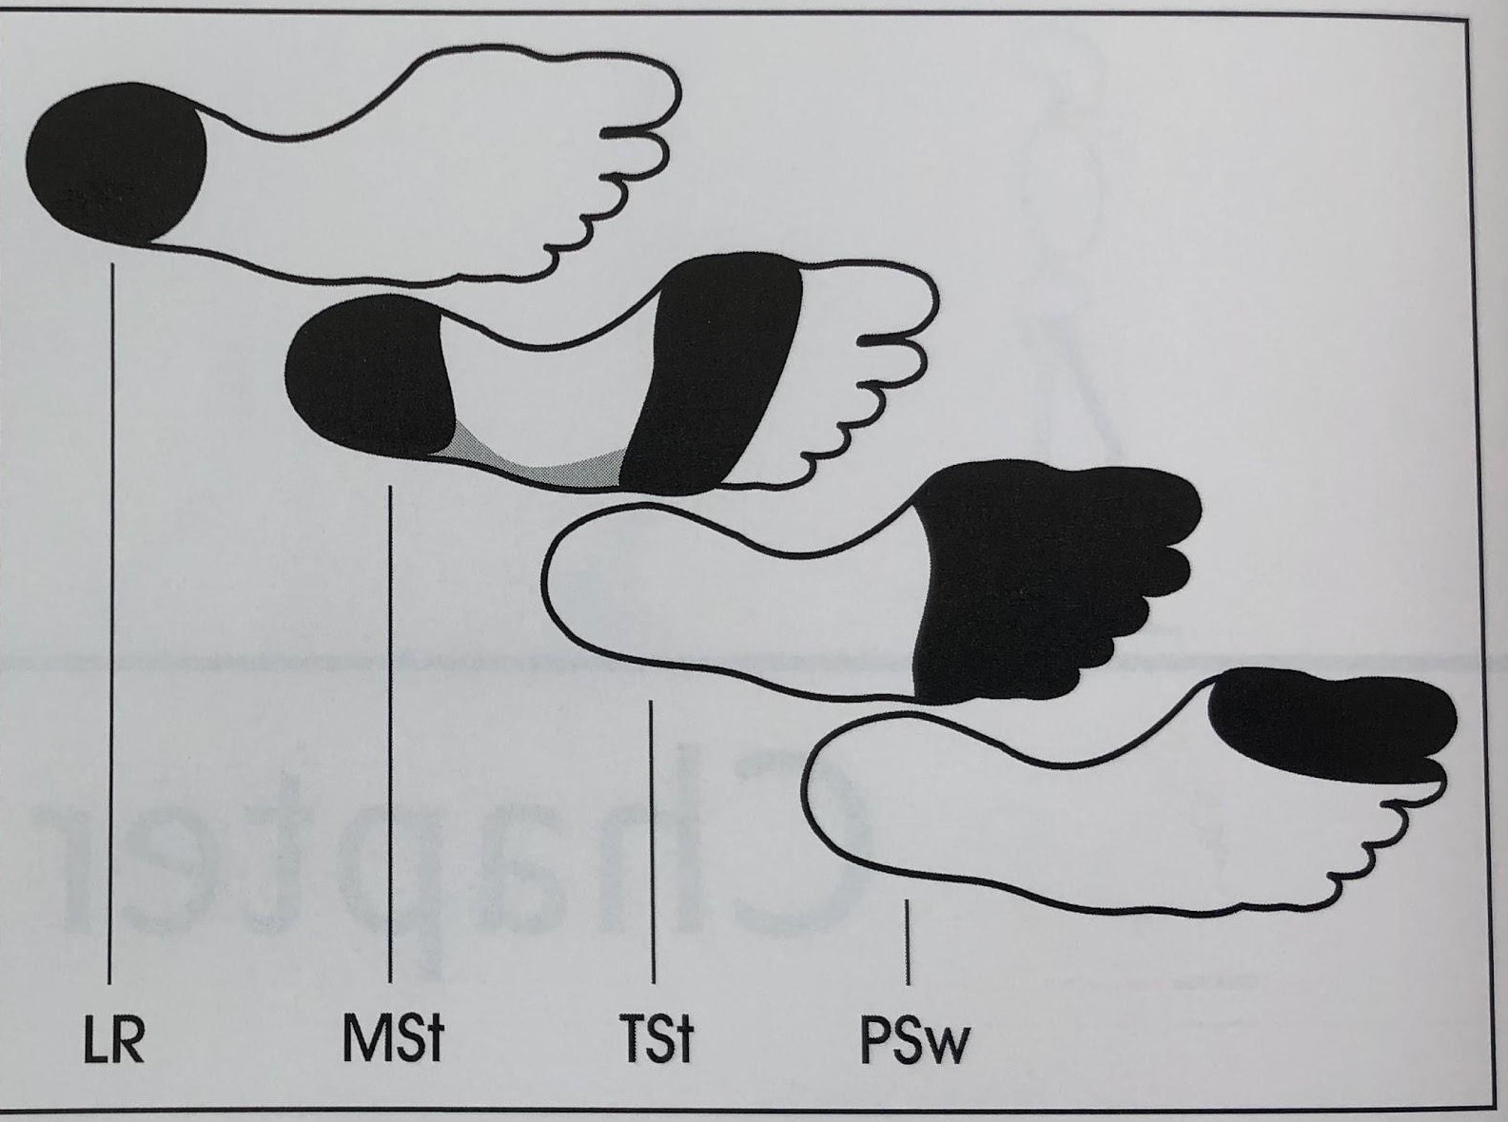
Medical Effects
Doctors Opinions: An orthopedic doctor and a physiotherapist were reached out to and asked for their opinions
Magnets have no found medical effects on the body
Could be effective in distributing weight effectively
This is a new take on impact absorption with less space used, but more effective
Medical Studies: Studies about the effect of magnets on the body
No effects were found that show any kind of effect
An unverified idea states that magnets can increase circulation due to the hemoglobin in blood cells
Anatomy and Gait Analysis: Studying the way the body walks and which area receives the impact
There's 4 stages of walking and none of them place force on the arch (Figure 8)
The Calcaneus and Talus are the 2 main bones of interest
Perry, J., & Burnfield, J. M. (2010). Gait Analysis: Normal and Pathological Function (2nd ed.). Thorofare, NJ: Slack Incorporated.
Figure 5: 4 Stages of Walking in Gait Analysis

Slide 7
Tools and
Instruments
Materials
1 Arduino Uno
1 Mx2125 Accelerometer
1 Breadboard
1 Medical Crutch
1 Spool of Ø .65 wire
6 Binder Clips
X-Acto/Utility Blade
Sharpie
Bandsaw
CNC Router
Cost: $0 (graciously provided by the school)
Provided by the school
Along with professional supervision

Slide 8
1 pair of men’s size 10 shoes
2 black zip ties
30.5 x 76 x .25 cm Rubber Sheet
30.5 x 70 x .24 cm Clear Polycarbonate Sheet
40, 2.5 x .32 x .32 cm Magnetic Blocks
60, 1.9 x .32 x .32 cm Magnetic Blocks
2, 3.18 x 20.3 cm Steel Plate
Aluminum Foil
2-Part Epoxy
2 Zinc-Steel Mending Plates
Cost: $13 (under budget constraint of $20)

Slide 9
Designing and Concept Sketches
Ideology and Approach
After experimenting with the Halbach Arrays for an extended period of time, it was noticed that…
The entire structure was really strong but could prove to be hard to build
Total time taken: 2 weeks
Initially, Circular Halbach Arrays were used
Various designs were made involving this configuration
Conceptual Issues were instability and difficulty
Building the circular pattern was too hard to keep constrained while it was curing
The thought of 3D Printing a support structure occurred as well but the process was too inefficient and ineffective for this purpose
Total time taken: 1 weeks
Figure 6: Halbach Array Arrangement
Figure 7: Circular Halbach Array Placement

Slide 10
Plan for construction
Utilize the engineering lab to create a small working prototype with an old pair of sneakers
The Halbach Array would be made out of several small block magnets
The magnets can be placed directly onto the shoe components (sole and midsole) for simplicity
Epoxy was used to join the midsole onto the sole
Total time taken: 6 weeks
Outer Shoe
Midsole
Sole
Figure 8: Visual of the magnetic repulsion system

Slide 11
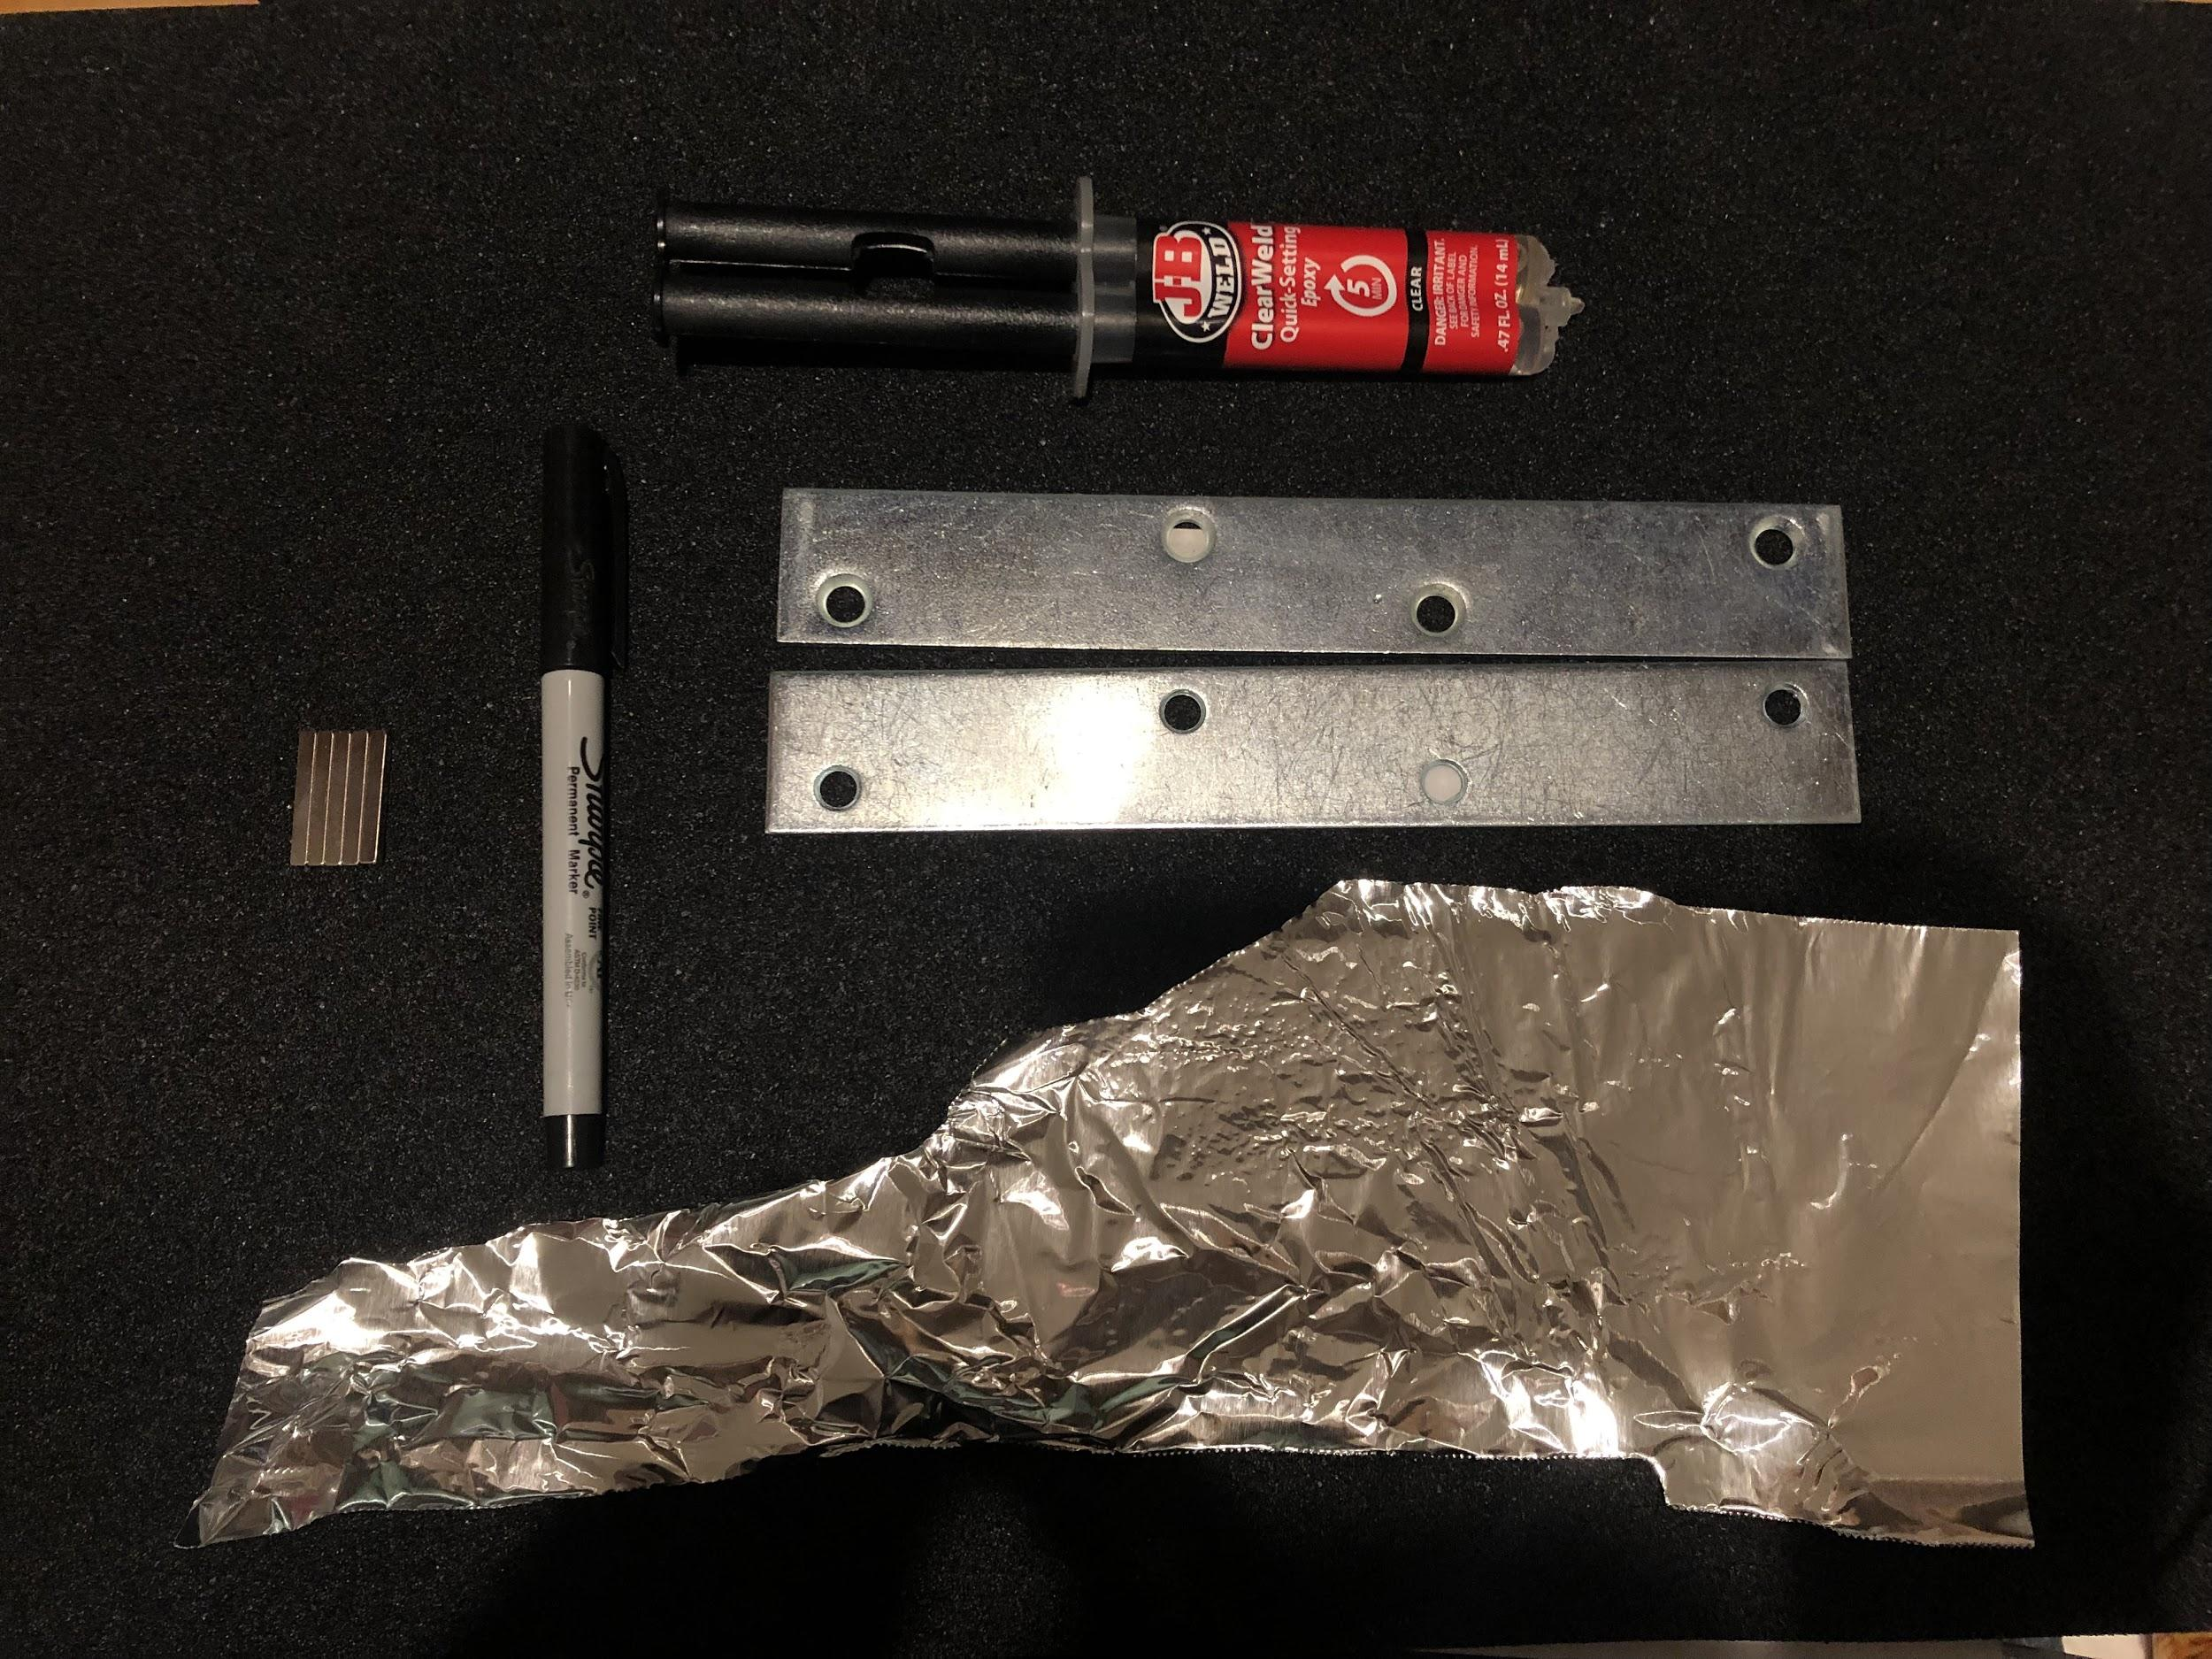
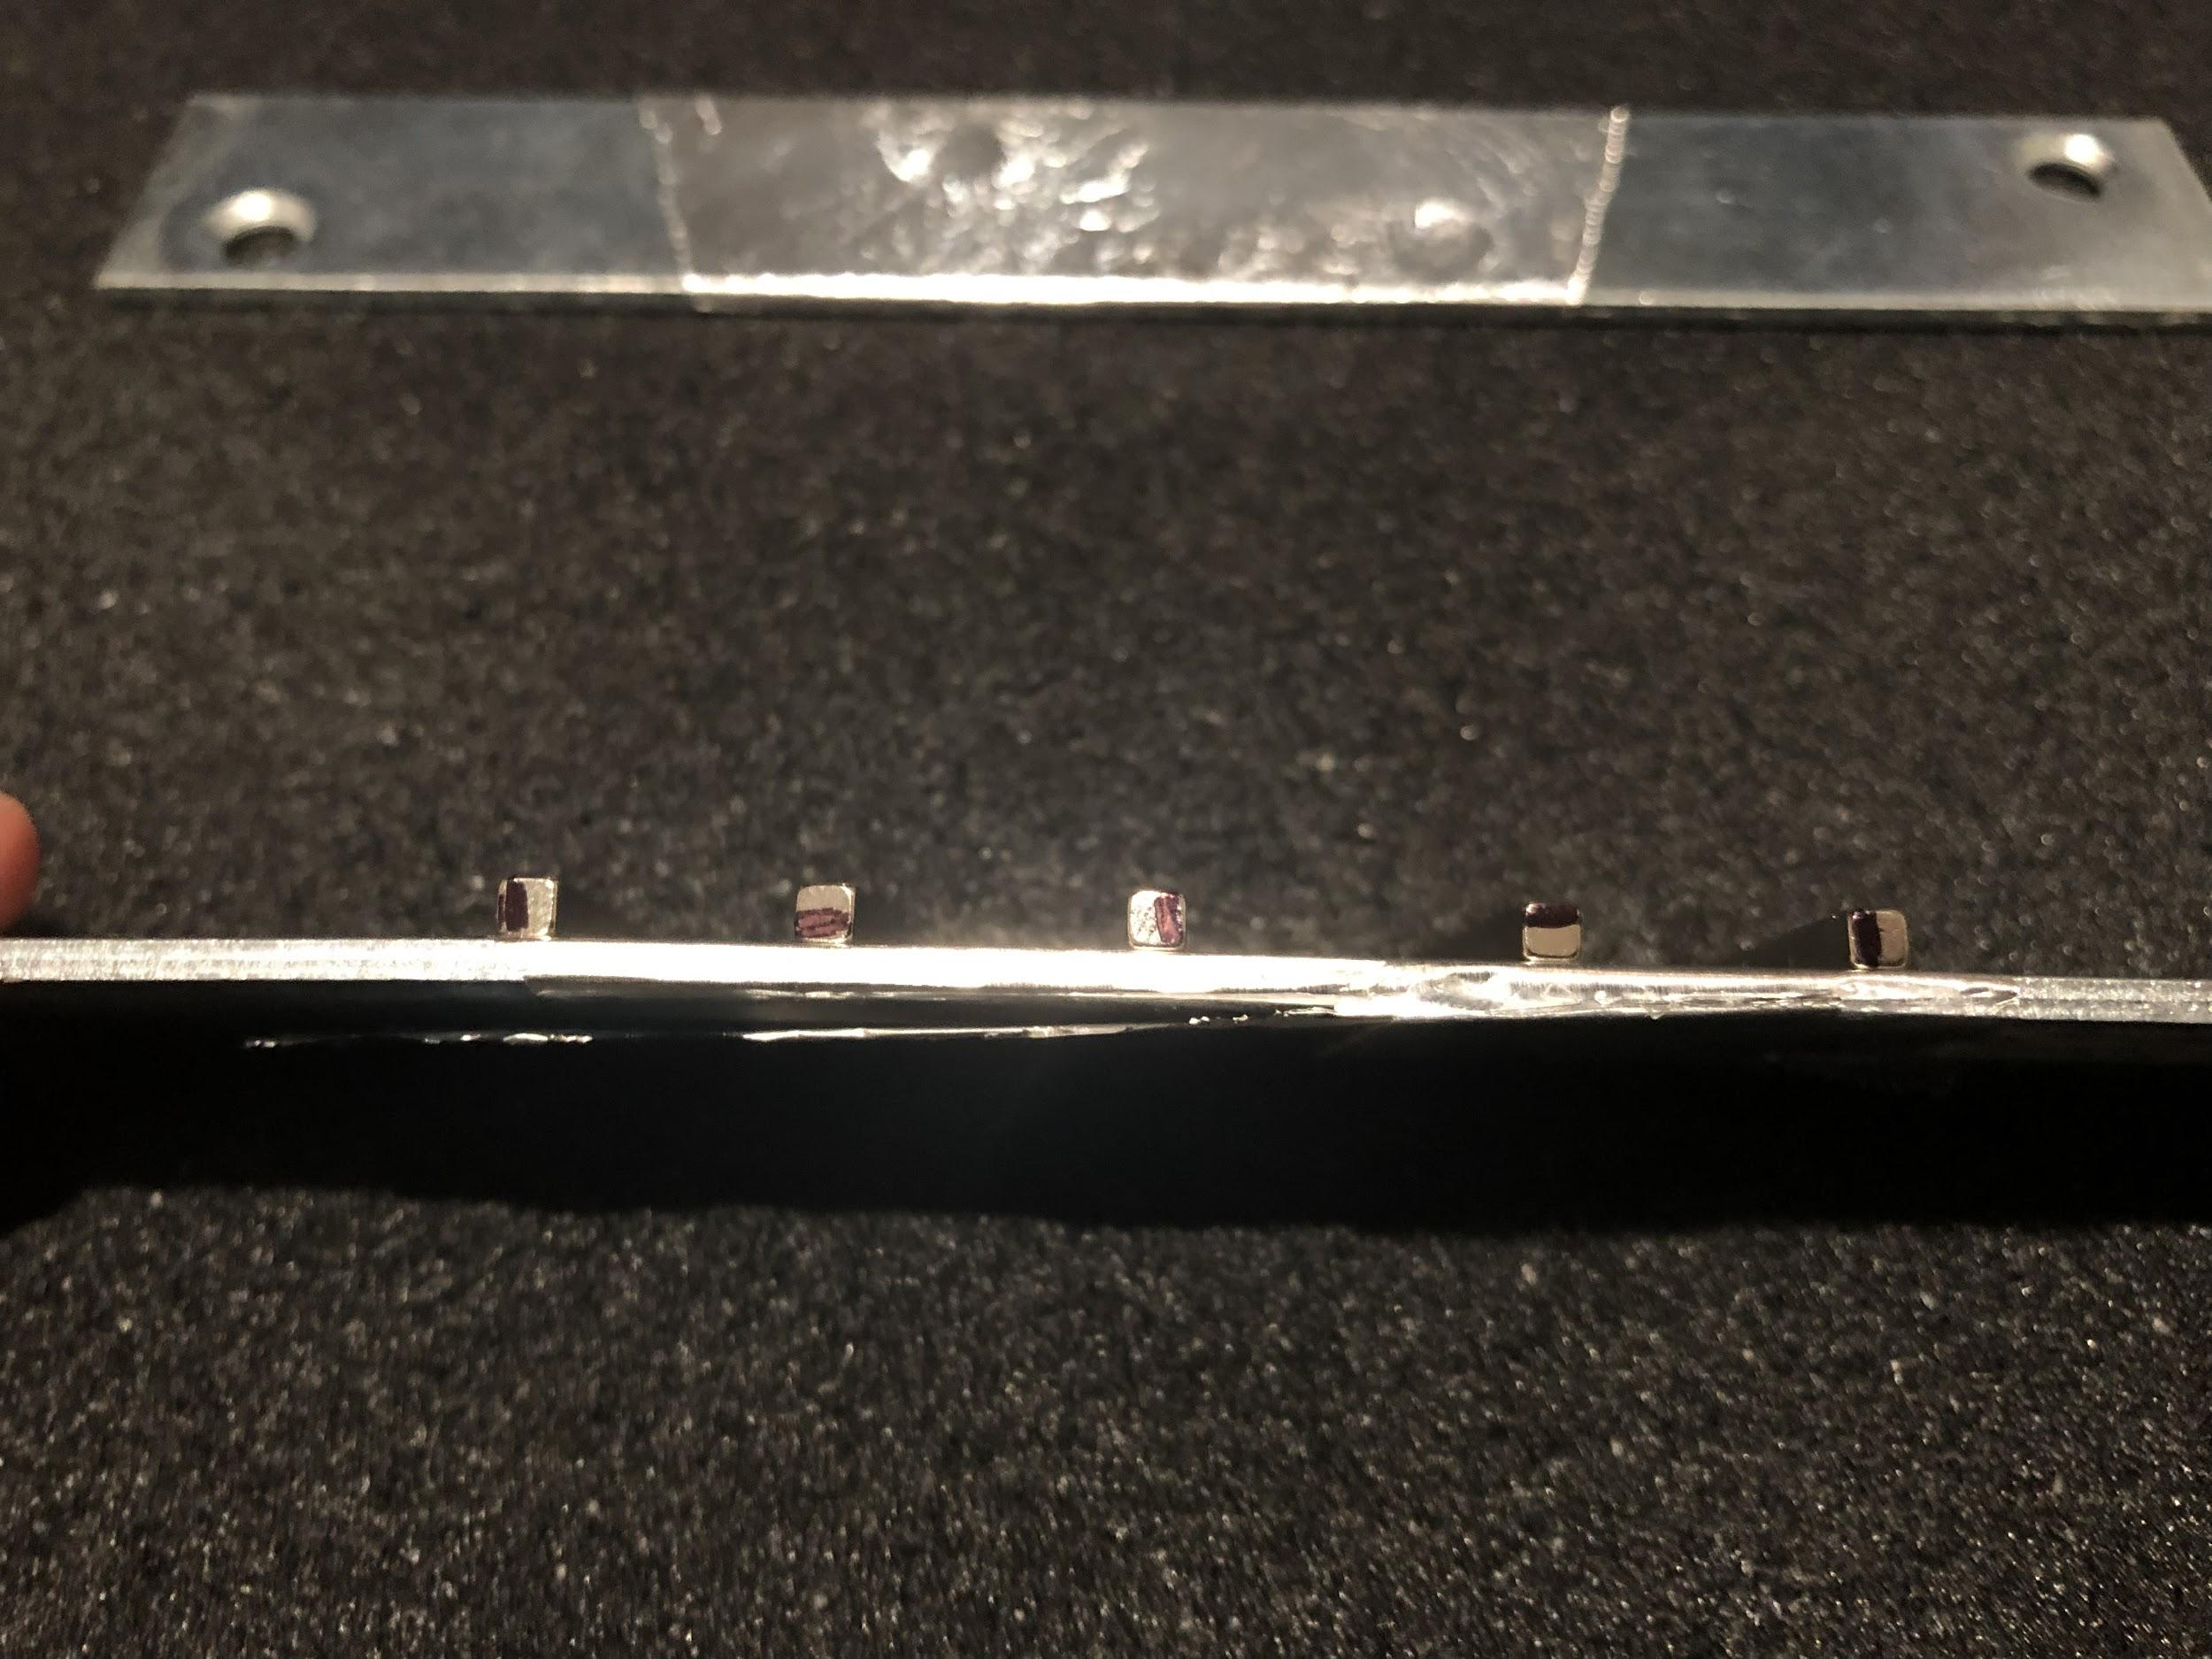
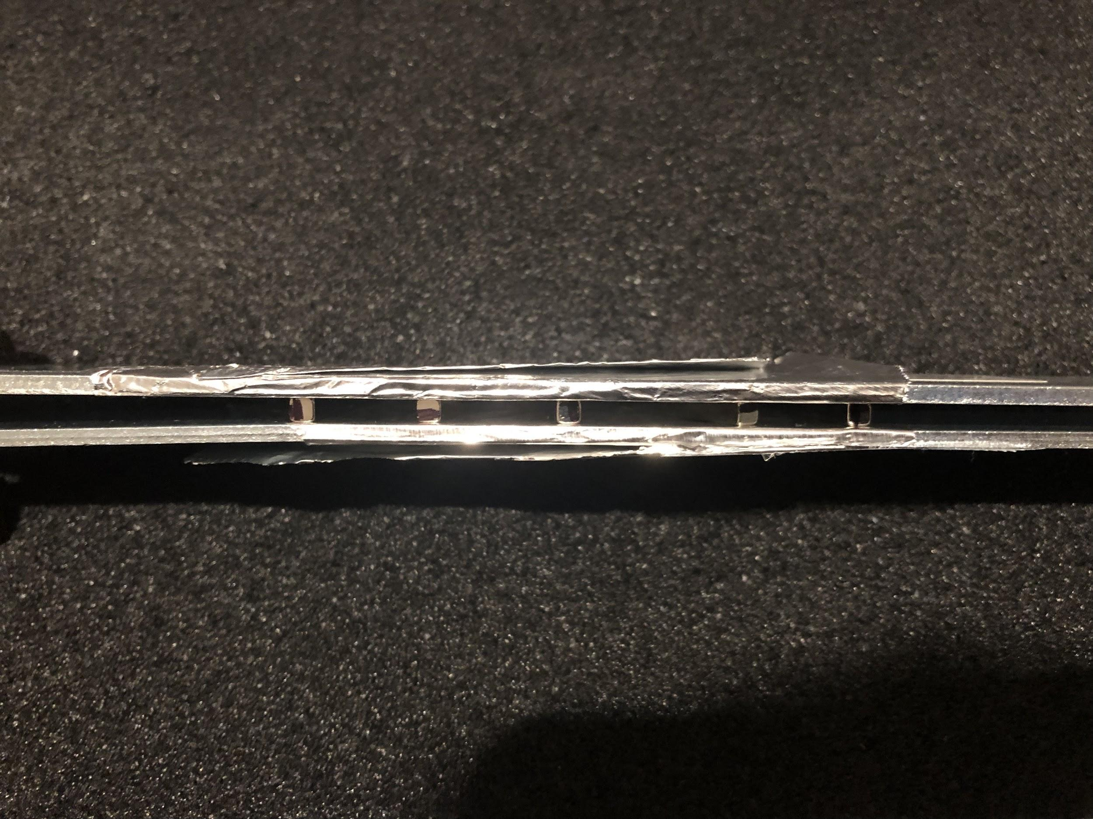
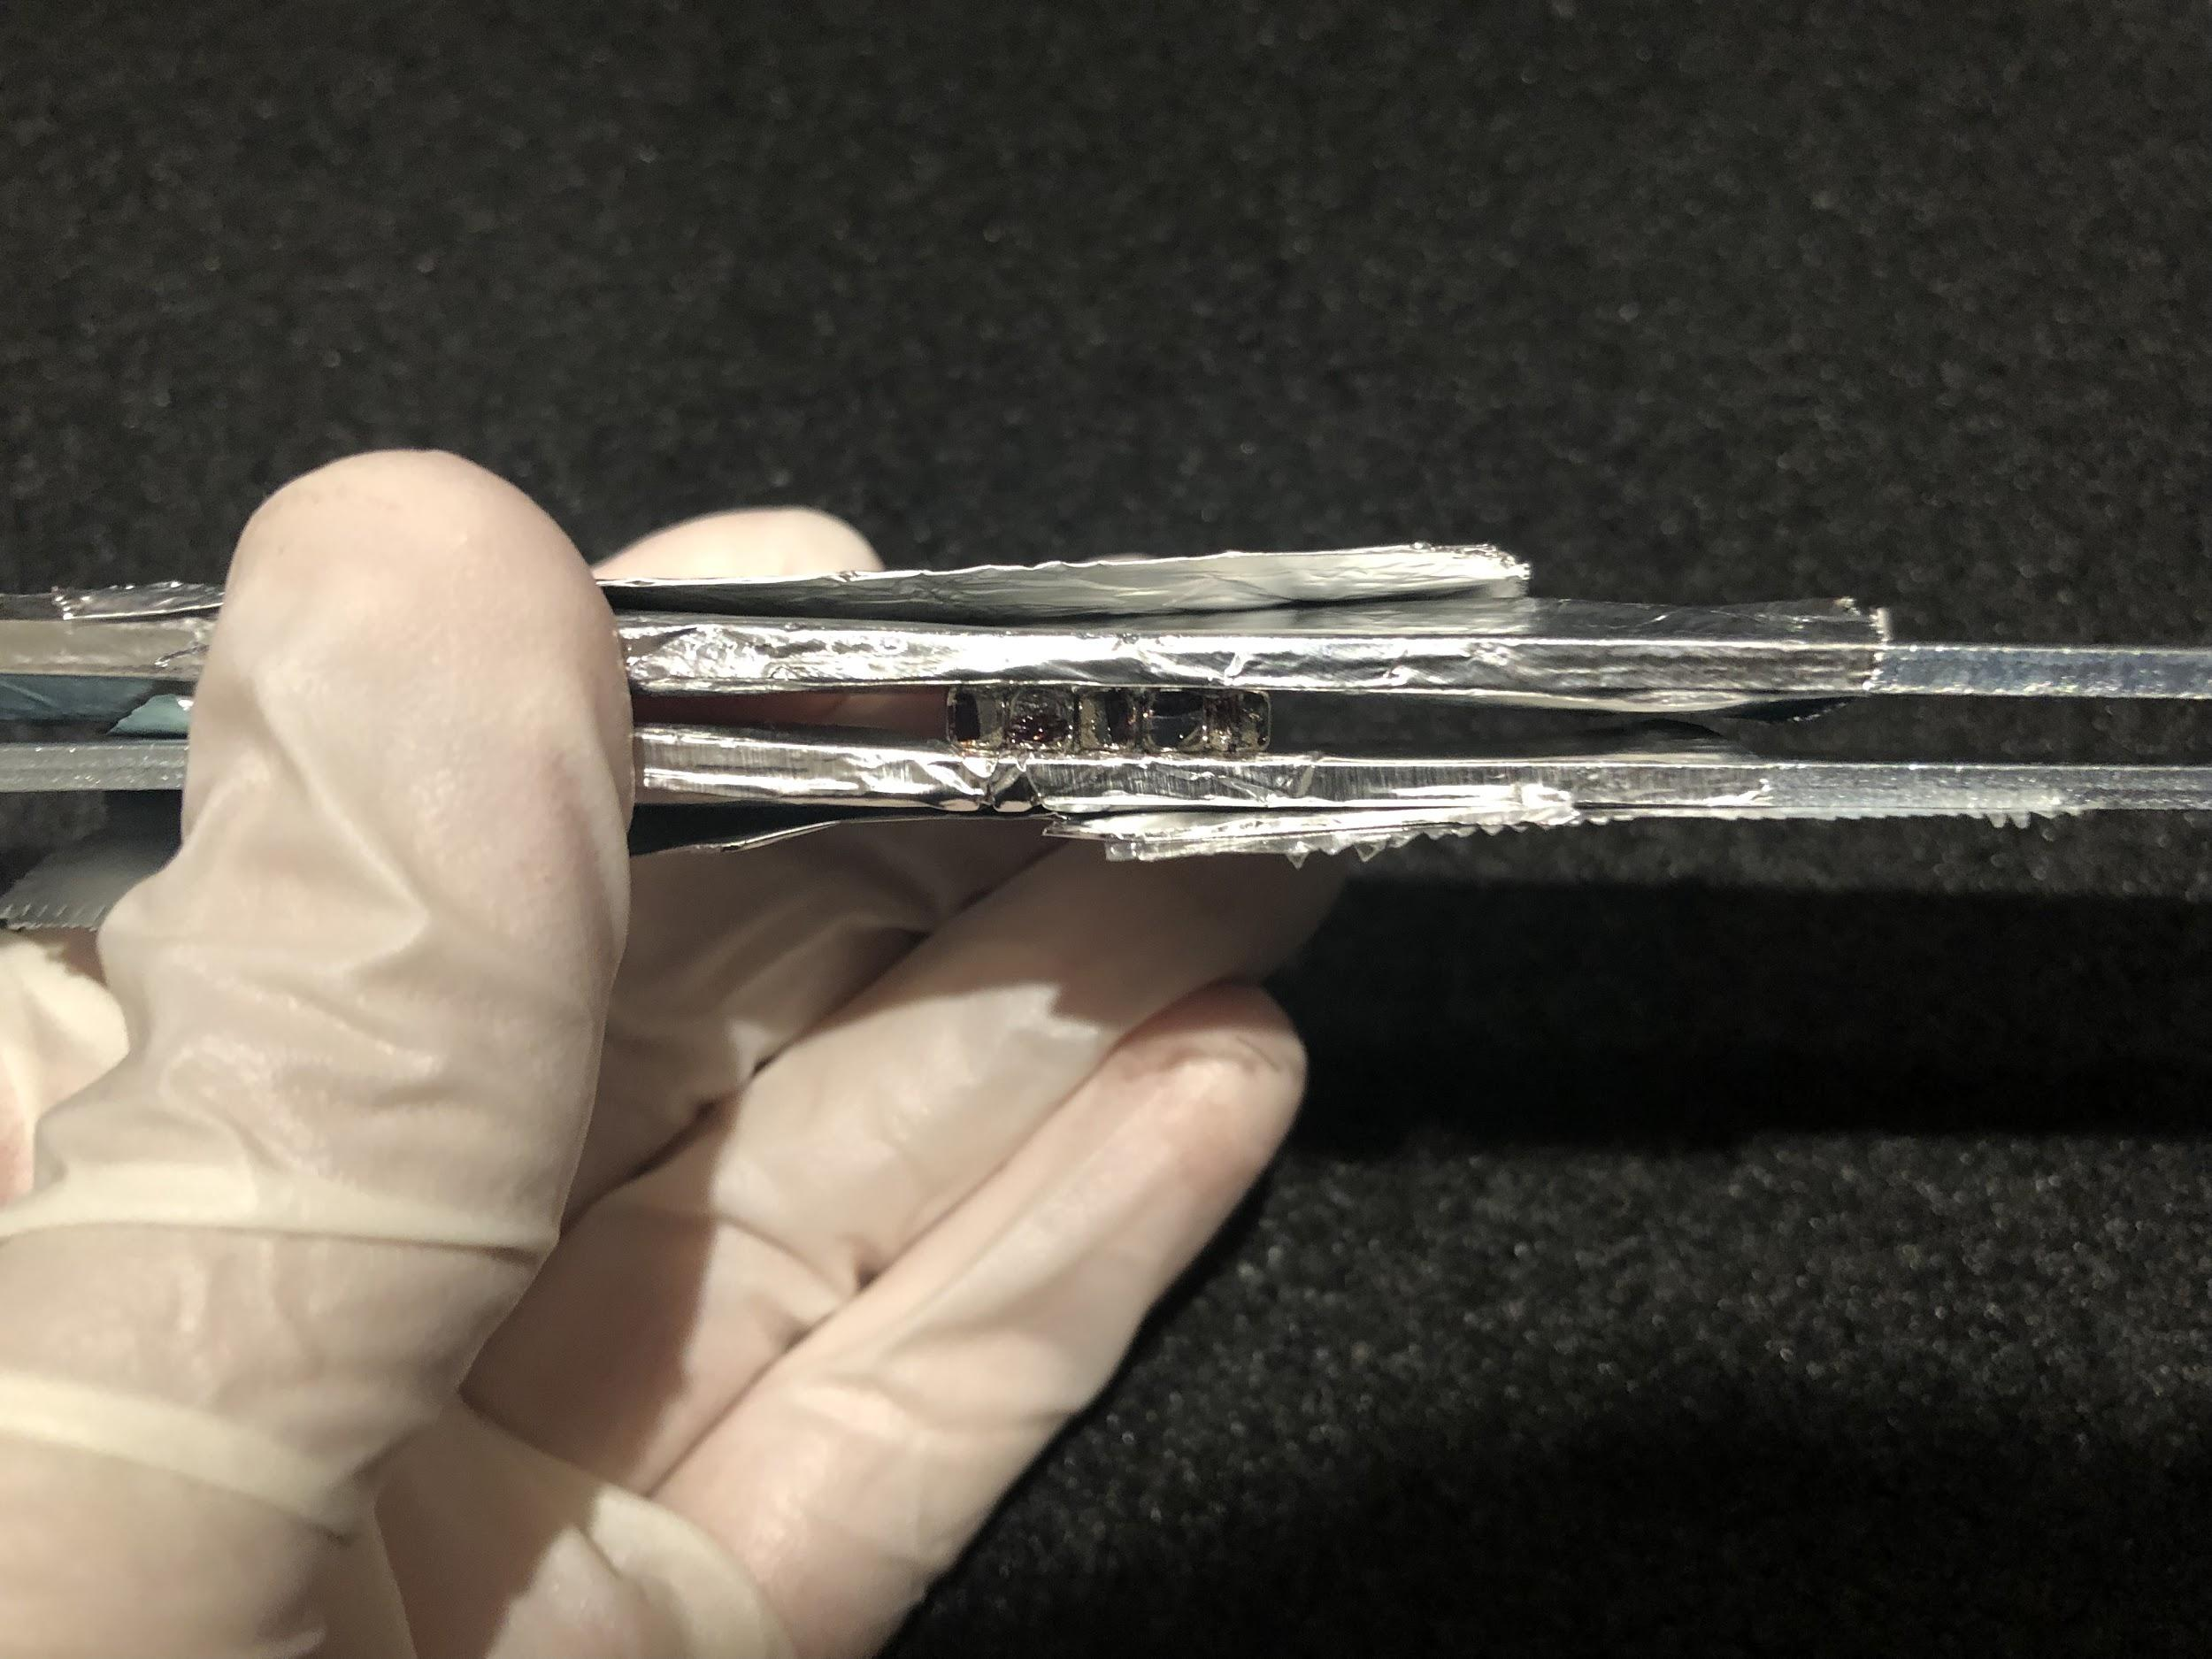
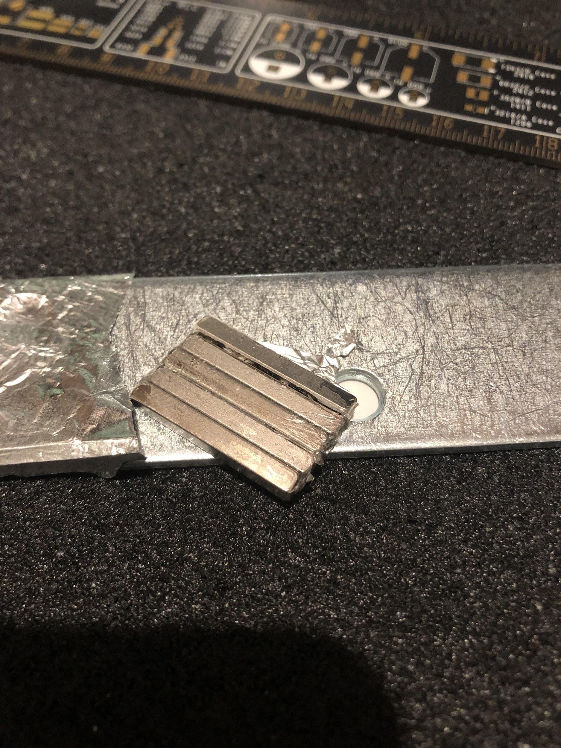
Building a Halbach Array
Wrap Steel Plates in Aluminum Foil
Mark same face on each edge of magnet with Sharpie
Place magnets on one steel plate in the configuration shown
Apply epoxy between each magnet
Place the second steel place on the other side of the magnets
Use a straight edge to sandwich the magnets together in the plates
Allow epoxy to cure for 24 hours before removing from plates
Figure 9: Halbach Array Arrangement
Figure 10: Procedure Steps 1, 3, 5, 6, and 7

Slide 12
Prototype X Construction Procedures
Shoe Preparation
Remove the midsole and upper shoe body from the shoe to reveal the sole
Find the locations the magnets based on the model created and mark their locations with a sharpie
Cut the outline of the markings with an utility knife with a depth of 0.8 cm
Bore out the outline with a utility knife for all the outlines to a depth of 0.8 cm
Magnetic Fixture
Place the Halbach Arrays loosely on top of their holes with 2-part epoxy resin on the top
Align the midsole onto the its original position in the shoe and place the Halbach Arrays on the other side of the midsole to act as a “clamp” to keep the them in their intended positions during gluing
Let the epoxy dry
Place the corresponding Halbach Arrays with matching polarities facing each other on one side and firmly push it into their holes
Final Assembly
Cover the exposed shoe bed with a thin layer of epoxy
Carefully align the midsole onto the marks made earlier and resist the magnetic repulsion as much as possible to ensure complete alignment
Press down on the midsole to ensure the seal and allow 24 hours to cure

Slide 13
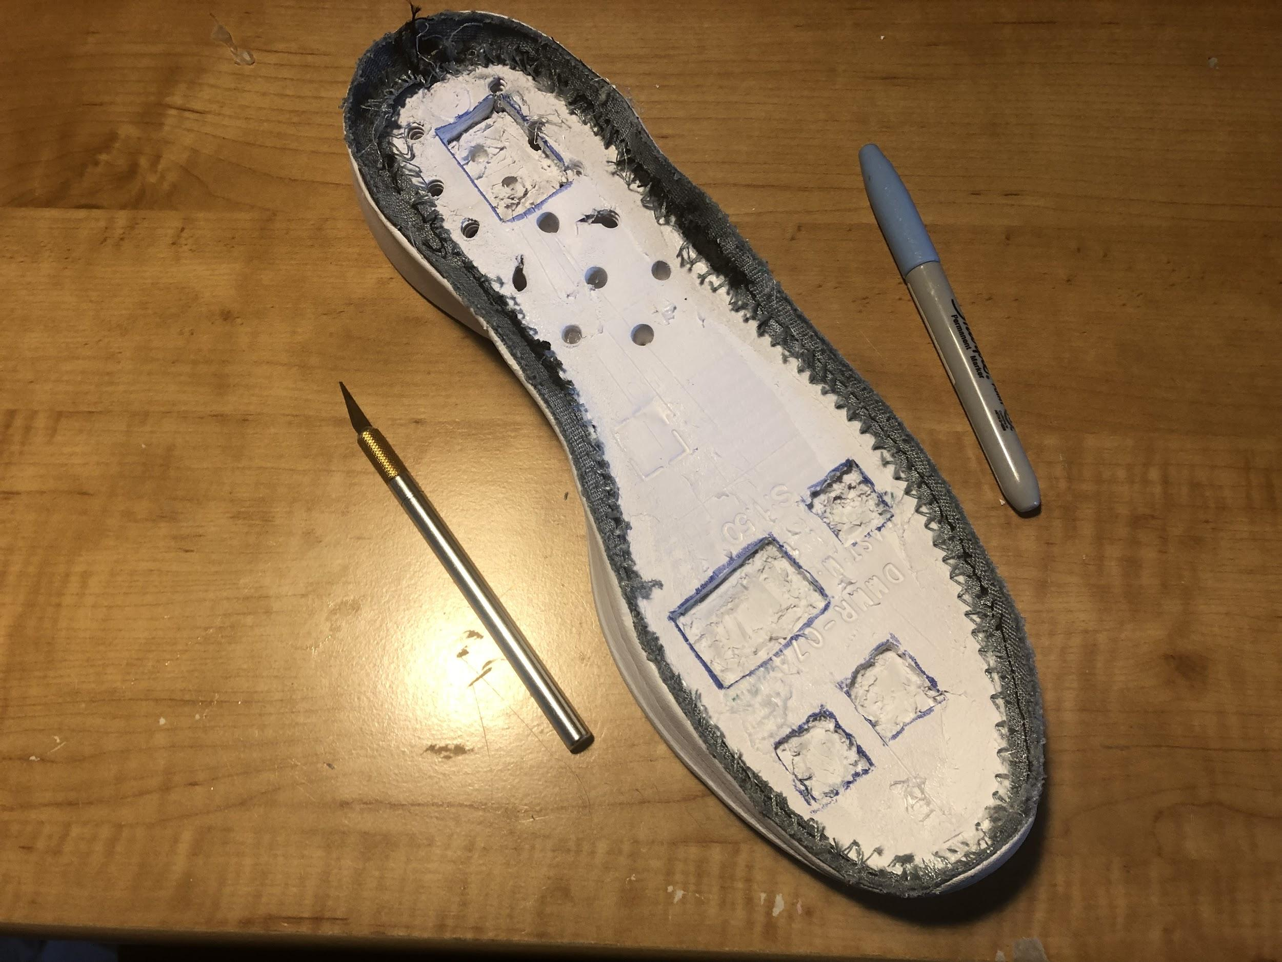
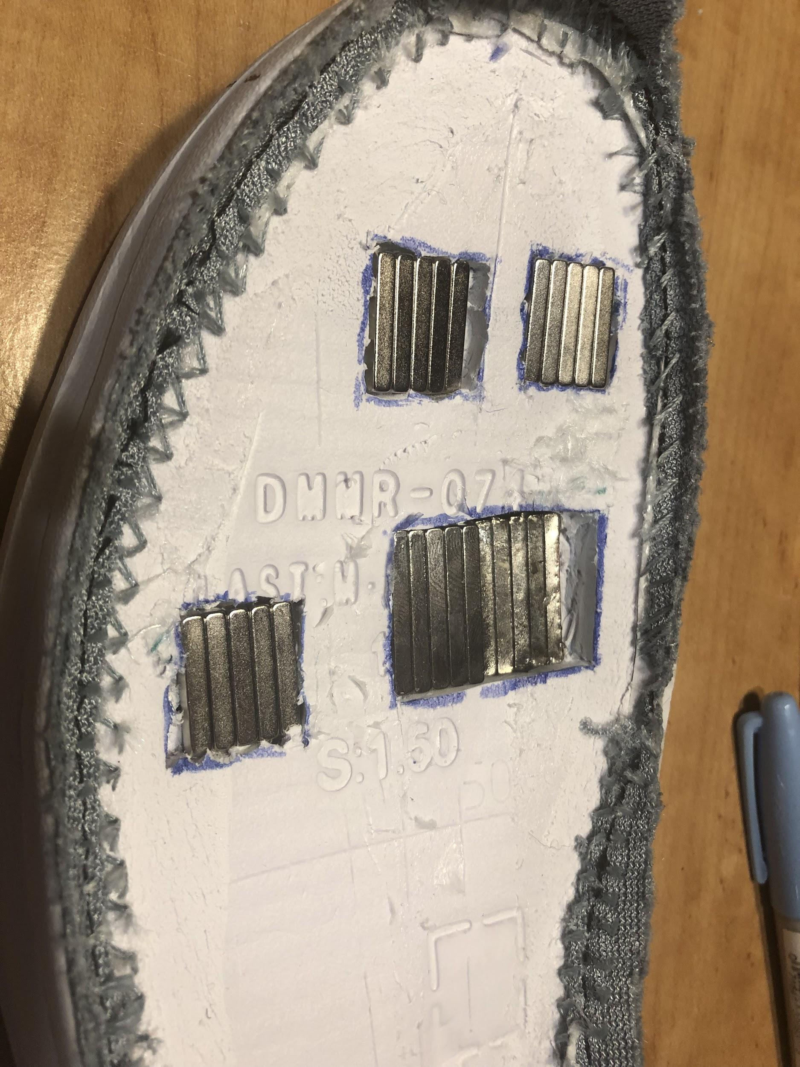
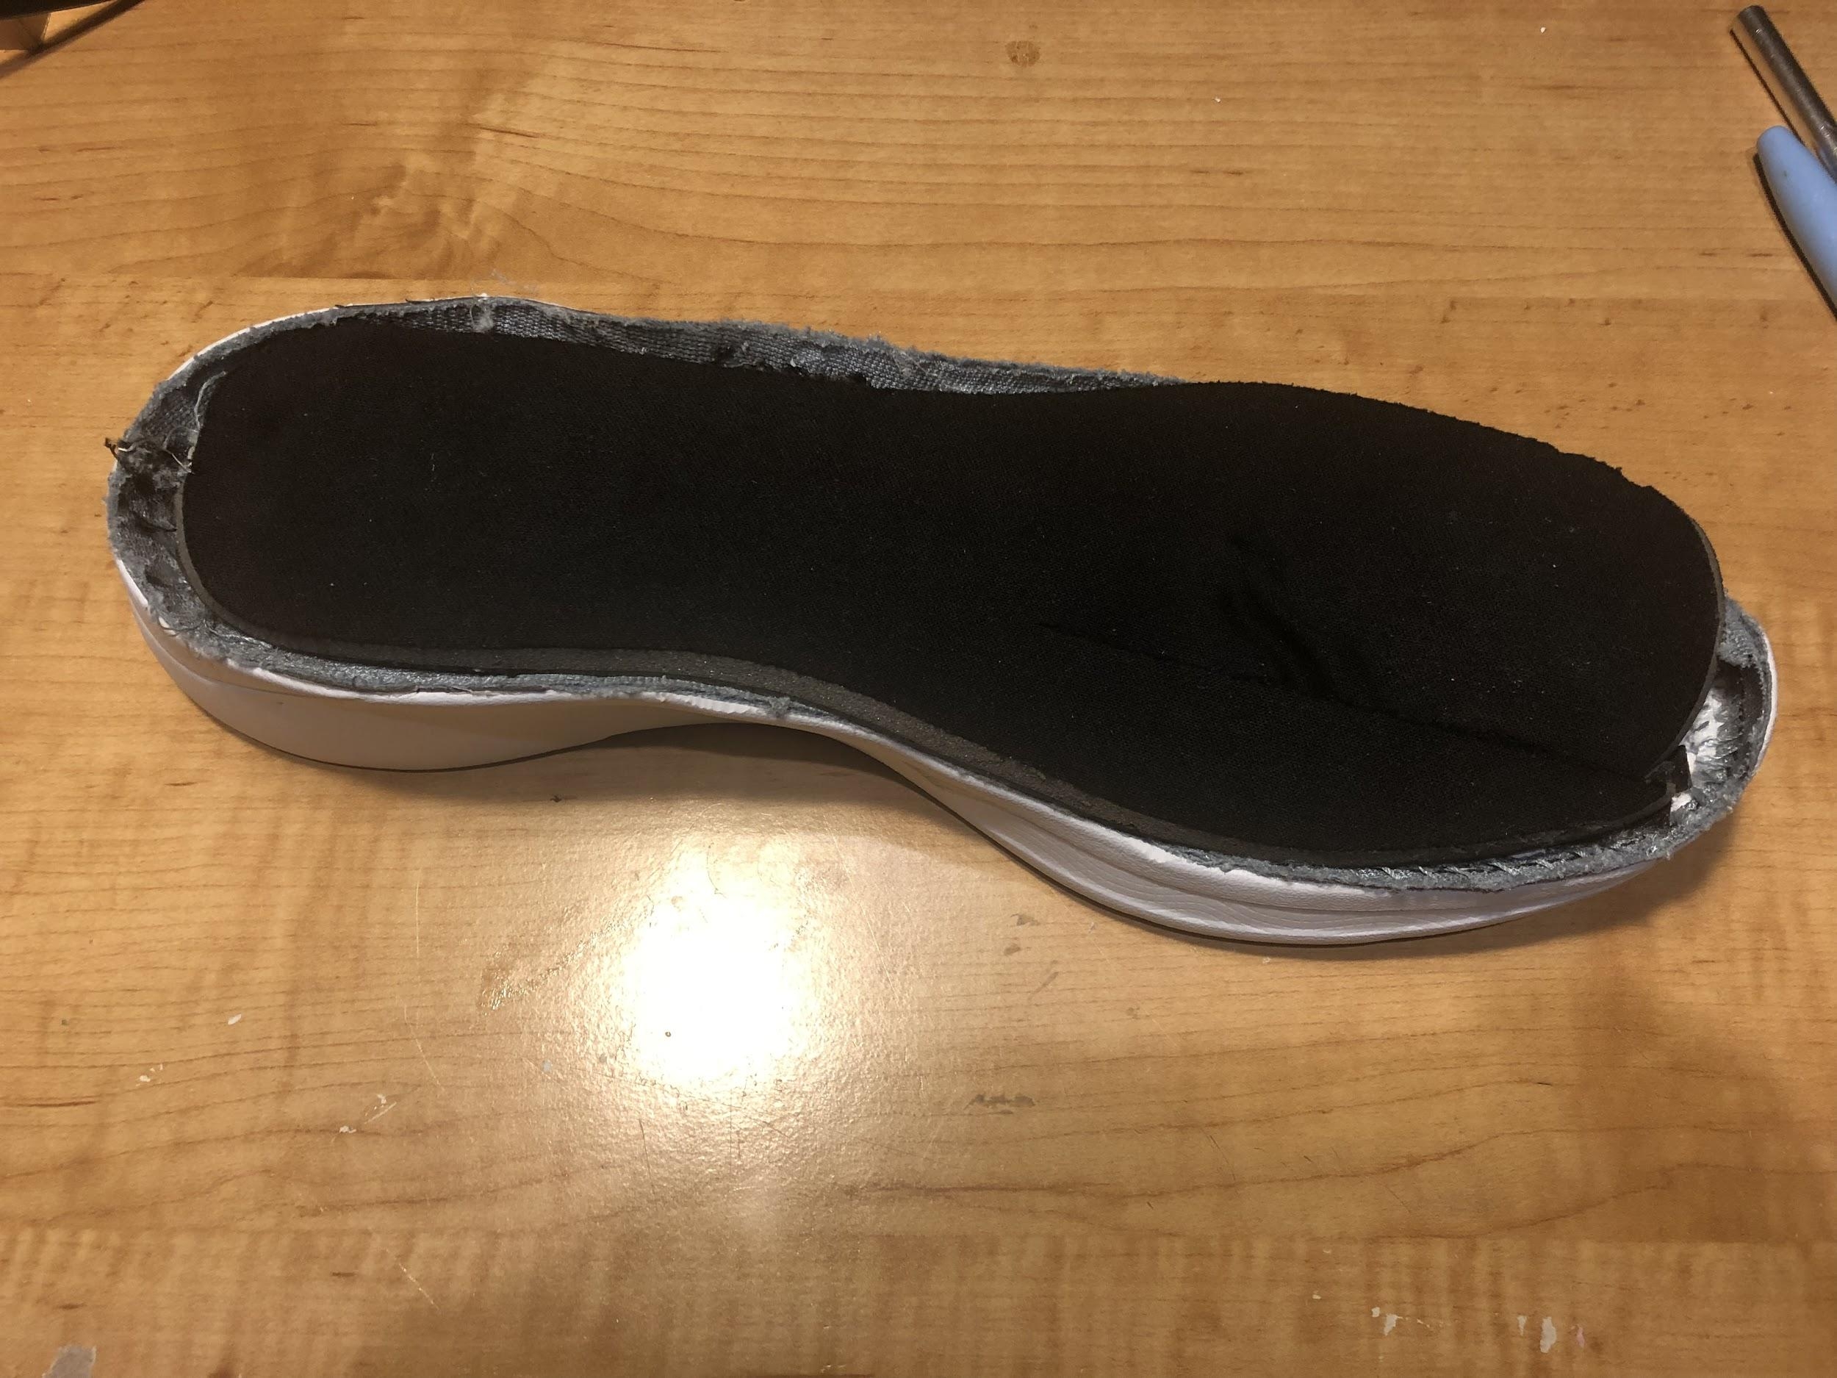
Figure 11: Shoe Preparation Step
Figure 12: Magnetic Fixture Step
Figure 13: Final Assembly Step
Figure 14: Cross Section of Prototype X

Slide 14
Issues &
Redesigning
The foam makes for an unnecessary thick and heavy shoe
If the form is no longer needed for cushioning, it merely serves as dead weight.
Fix: A better option is to make my own shoe sole from scratch that follows what I need
This may be a tougher option but it seems like the right way to go in order to save weight, cost, and for simplicity
Options are making my own lightweight polyurethane foam or using a thin and durable sheet of rubber
With Prototype X

Slide 15
Prototype Y Construction Procedures
Shoe Preparation
Trace and cut out 2 sole patterns of shoe on rubber sheet, one being bigger with an excess margin of 5 mm
Magnetic Fixtures
Find the locations the magnets based on the model created (from the prior year) and mark their locations with a sharpie
Glue Halbach Arrays, all with the same polarity, onto the positions marked
Repeat the same step on the other sole pattern
Final Assembly
Place the smaller sole pattern with the magnets facing up on the table
Apply a layer of epoxy in the areas around the magnets except within a radius of 1 cm and the rest of the exposed shoebed
Place the edges of the larger sole pattern on the edges of the smaller one and match the edges up
Press on the other areas around the magnets
Hold them together for 5 minutes to allow the bond to form

Slide 16
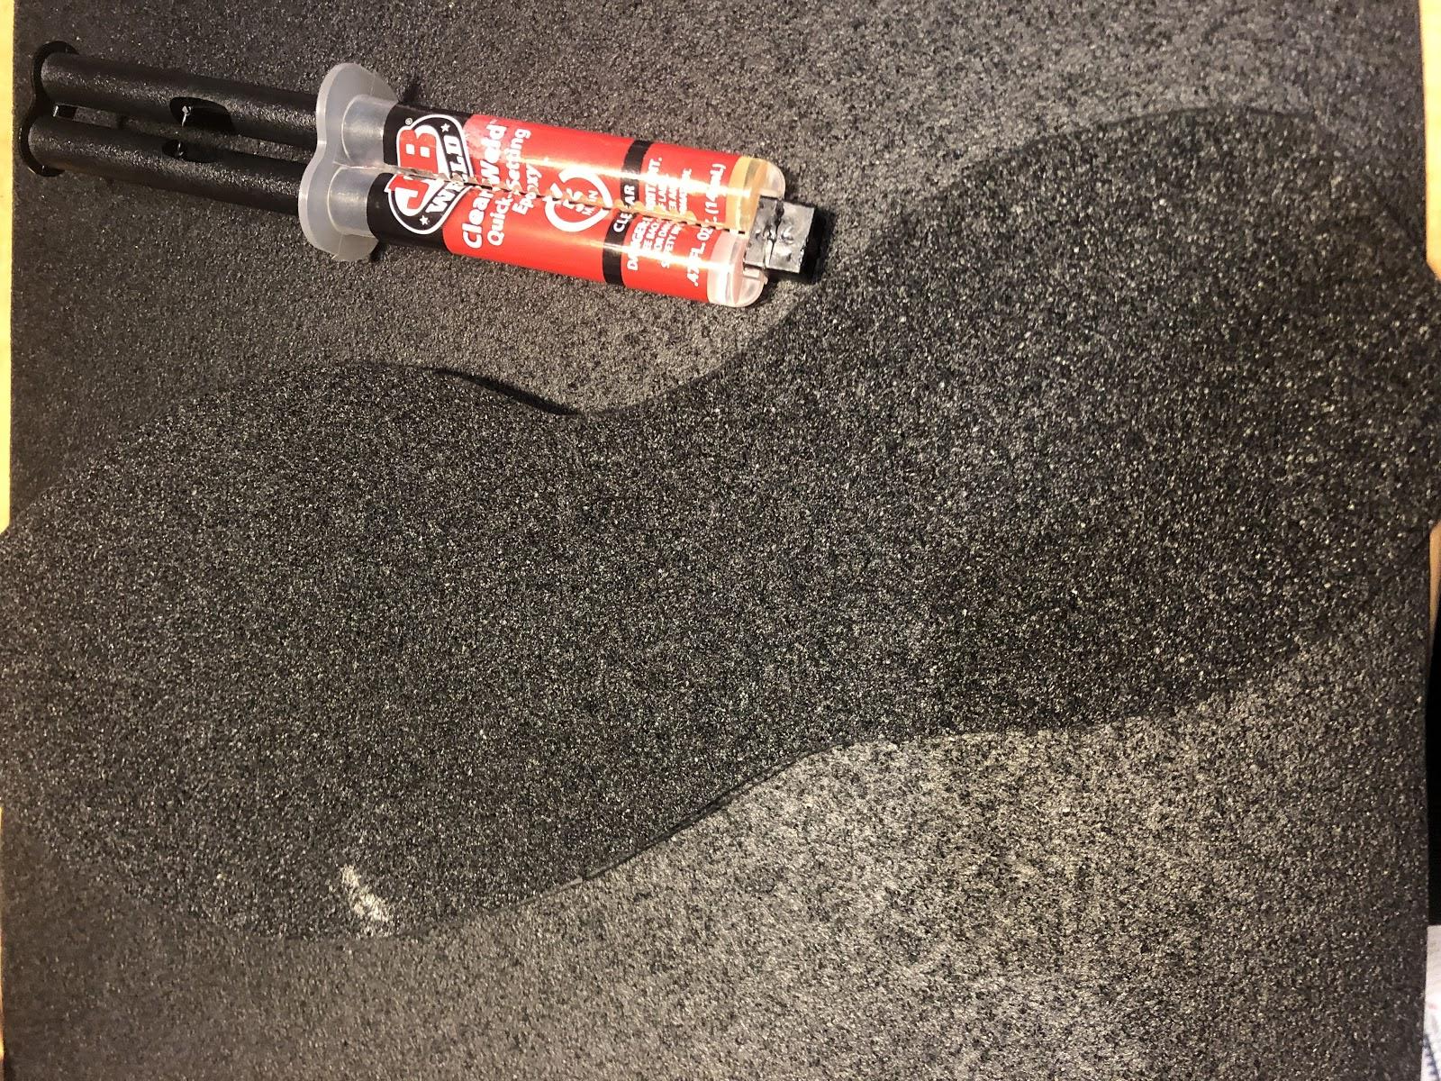
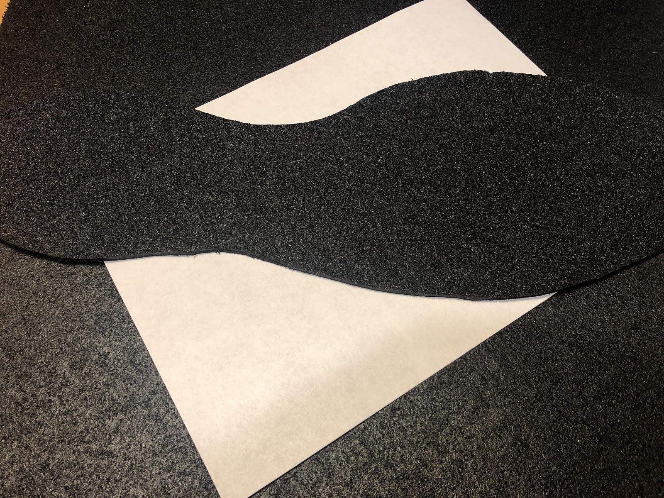
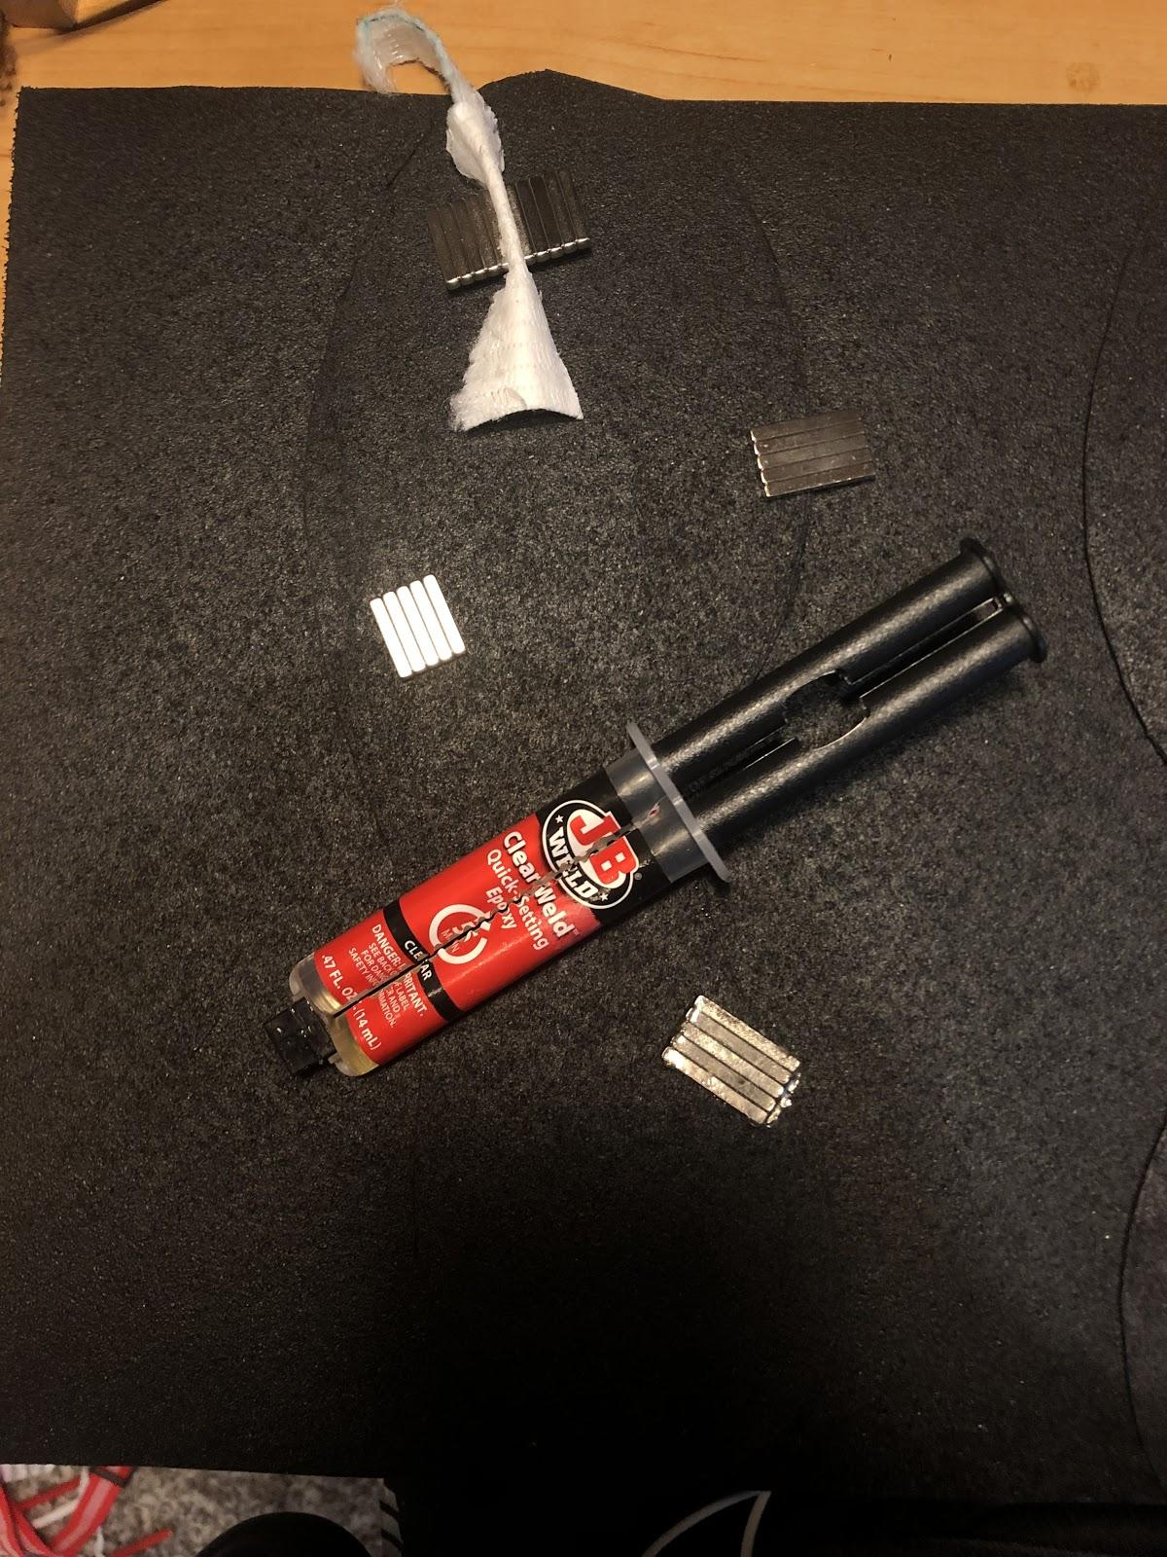
Figure 15: Shoe Preparation Step
Figure 17: Final Assembly Step
Figure 16: Magnetic Fixtures Step
Figure 18: Cross Section of Prototype Y

Slide 17
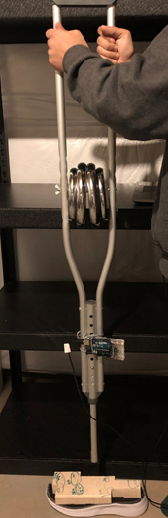
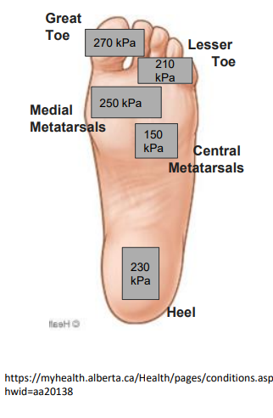
Testing - Prototypes Y and Z
A microcontroller was wired to a small accelerometer to measure deceleration
A crutch was modified so that the hand grip was replaced with a metal rod that could hold the required barbell weights for testing and the rubber on the bottom leg was removed to simulate a more accurate barefoot-style test
To measure force across the entire foot, a 26.7 cm x 8.9 cm x 3.8 cm
wooden block was cut to produce a certain percentage of the pressure
based on the surface area. The purpose of this was to spread the force
of the weights across the entire shoe. The data used came from a study
which measured pressure across the foot. The surface area was
calculated to be proportional to the pressure the area takes.
The bottom of the block was the chiseled to conform to the surface
of the shoe, while maintaining the distinction in area created instep 3.
32 kg (average weight of a leg) was dropped from a height of 2 cm
(average height of a footstep) 30 times each on the unmodified shoe,
a shoe with memory foam, and a modified shoe with memory foam.
Steps 3-5 were repeated to complete the running aspect of testing
Figure 19: Plantar Pressures recorded while walking (used in testing block). (Perry, 2004)
Figure 20: Testing Setup

Slide 18
Issues/
Redesigning
After 120 trials, I noticed the rubber wasn’t folding as originally thought when the magnets compressed
The rubber was not flexible in order to accommodate the compression from the levitation
Fix: Revert back to the original insole to contain the magnets but keep the rubber on the bottom for thin, practical, and durable protection
The rubber had almost no rigidity
This meant that the rubber had no firm support and instead had a loose, floppy structure
Fix: Add a light, flexible, and rigid plate layer in the middle of the shoe to provide structure and support
With Prototype Y

Slide 19
Prototype Z Construction Procedures
Shoe Preparation
Cut a shoe plate from a rubber sheet and a polycarbonate sheet of the same size
Mark the locations of the magnets on the insole with a Sharpie
Place the insole and polycarbonate sheet together and trace the edges and the magnet locations
Magnetic Fixture
Place a piece of steel under the insole and place the magnets all facing the same direction using the steel plate to hold them down
Apply epoxy and allow time to cure
Repeat steps 4-5 for the polycarbonate shoe plate
Final Assembly
Place the piece of steel in between the two layers and align them
Apply epoxy to only the edges to create a complete bubble and encapsulate that area of magnets
Add a small piece of foam in between each pair of magnets to provide protection
Use binder clips to clamp down on the areas of epoxy until cured
Move the steel plate accordingly to keep control of magnetic levitation while applying epoxy to the edges
Apply epoxy to the unused side of the polycarbonate
Place the rubber shoe plate on the epoxy and allow time to cure

Slide 20
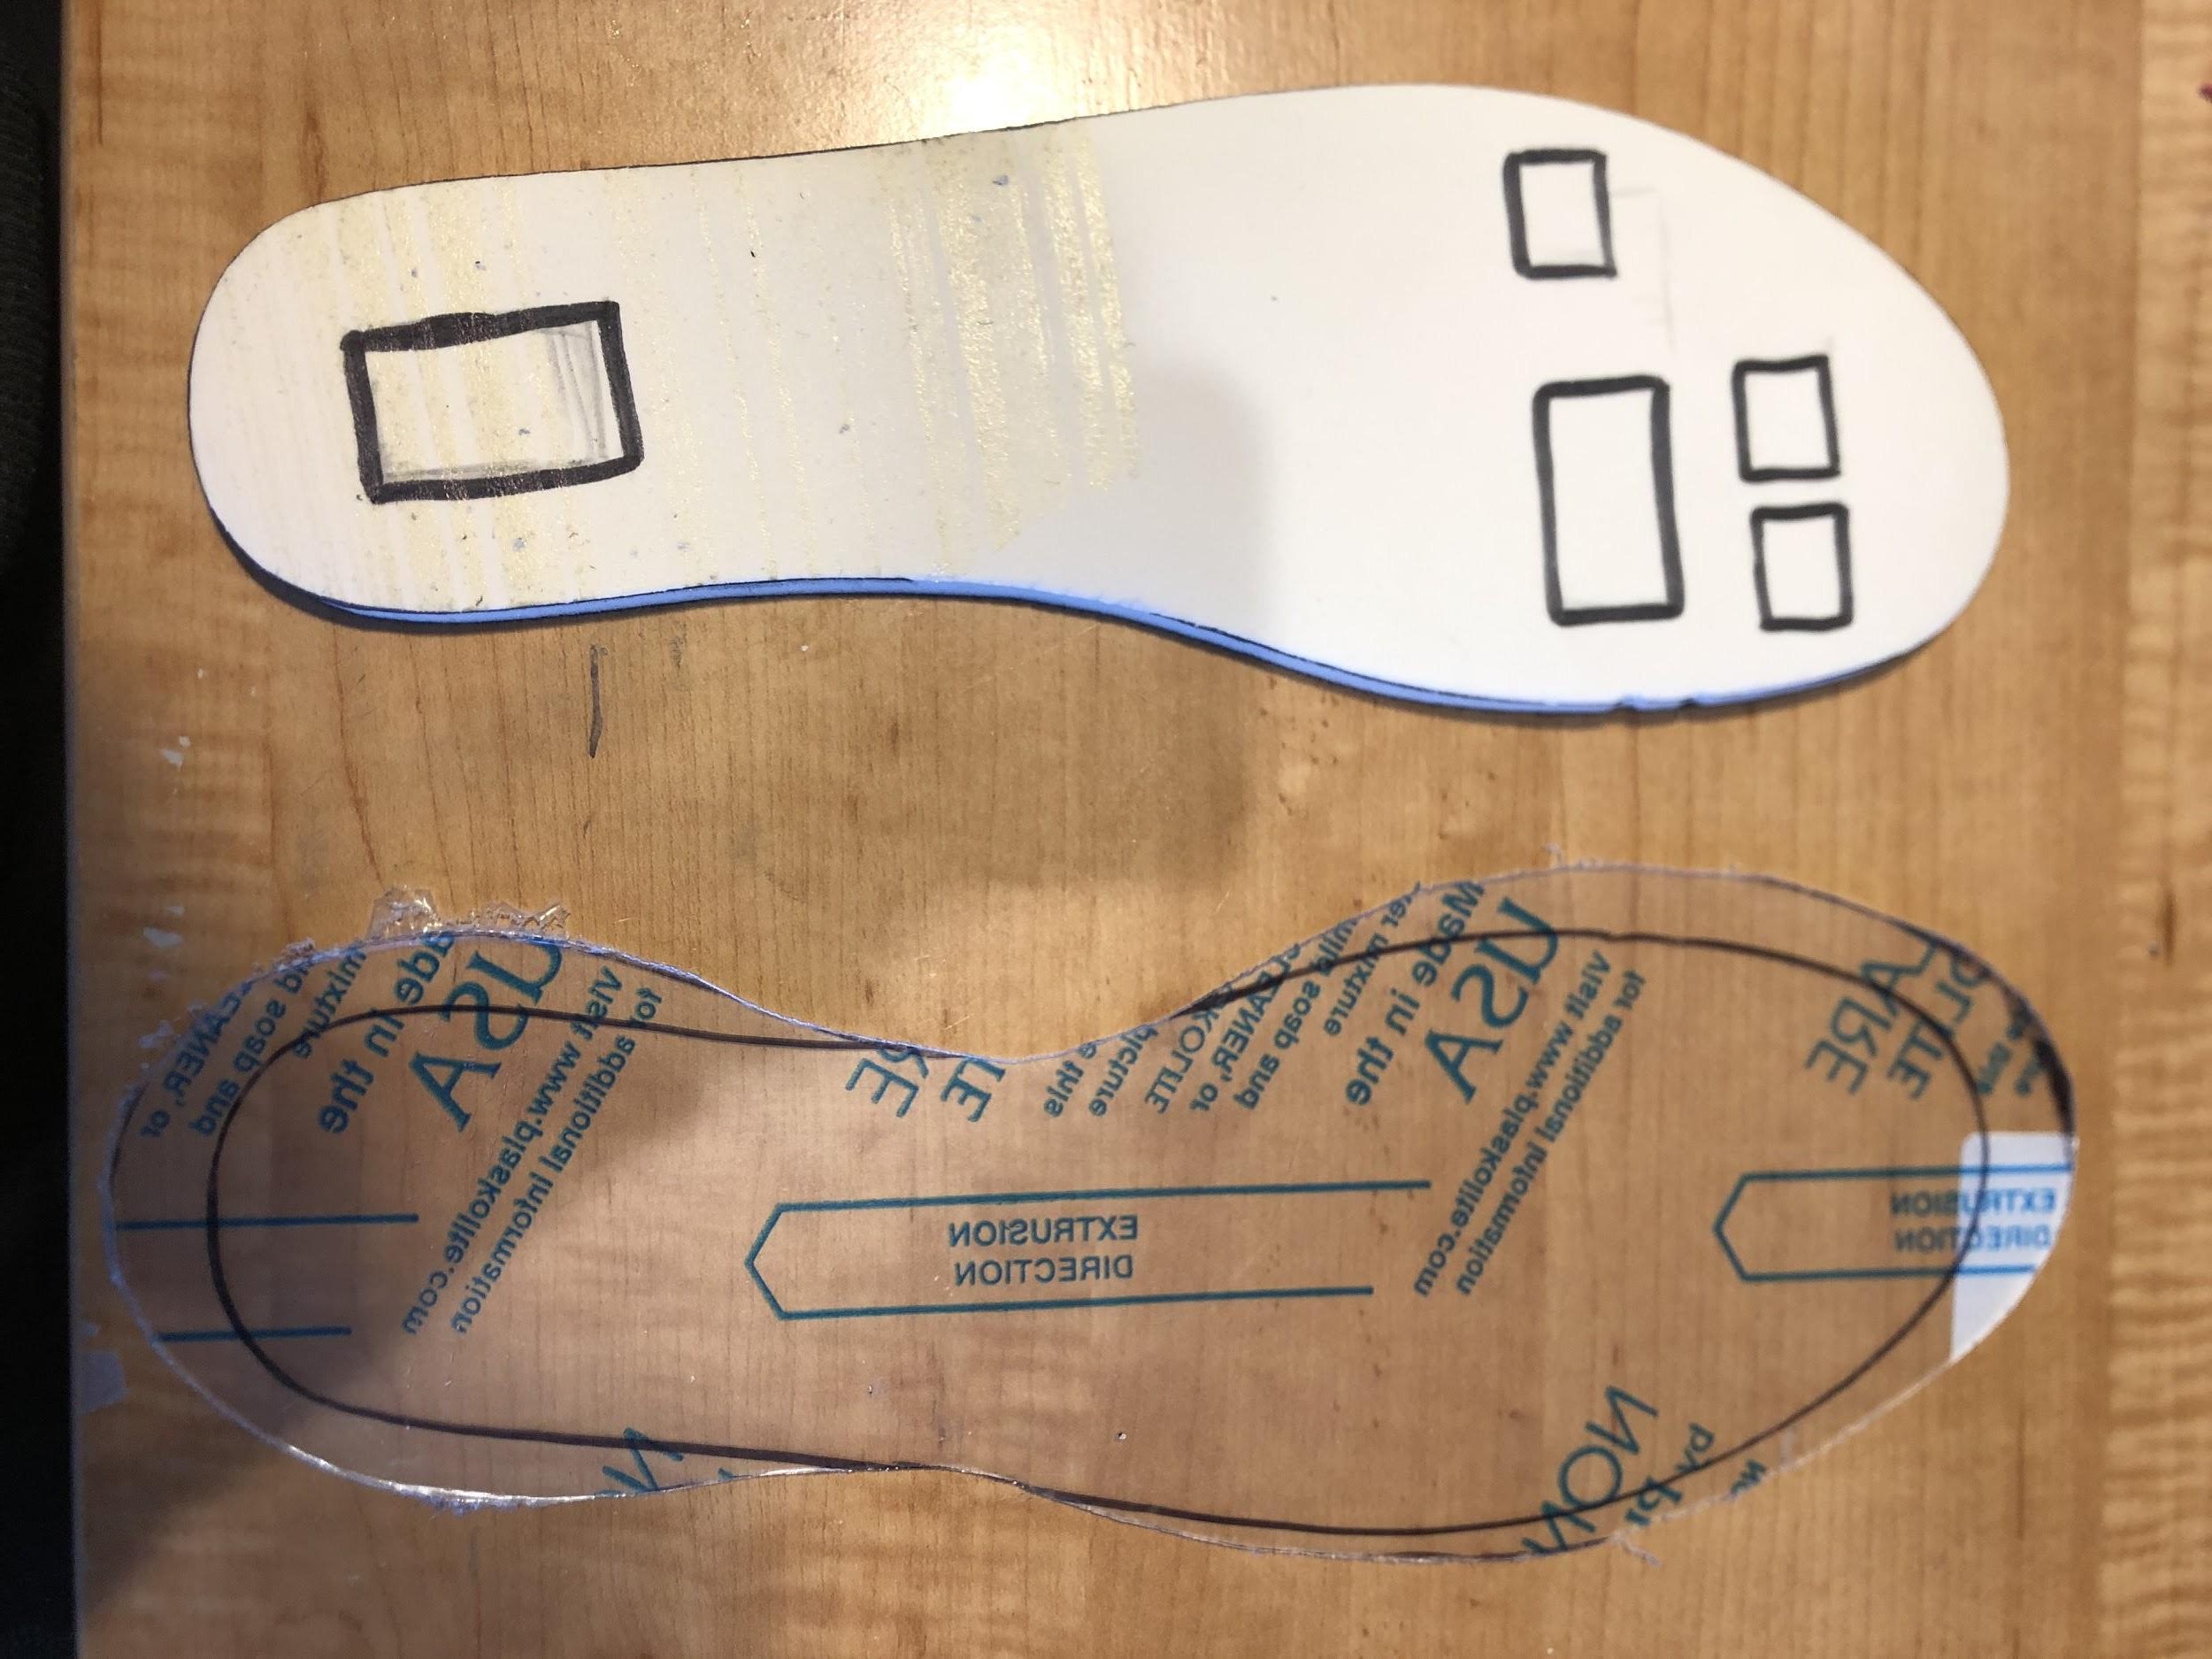
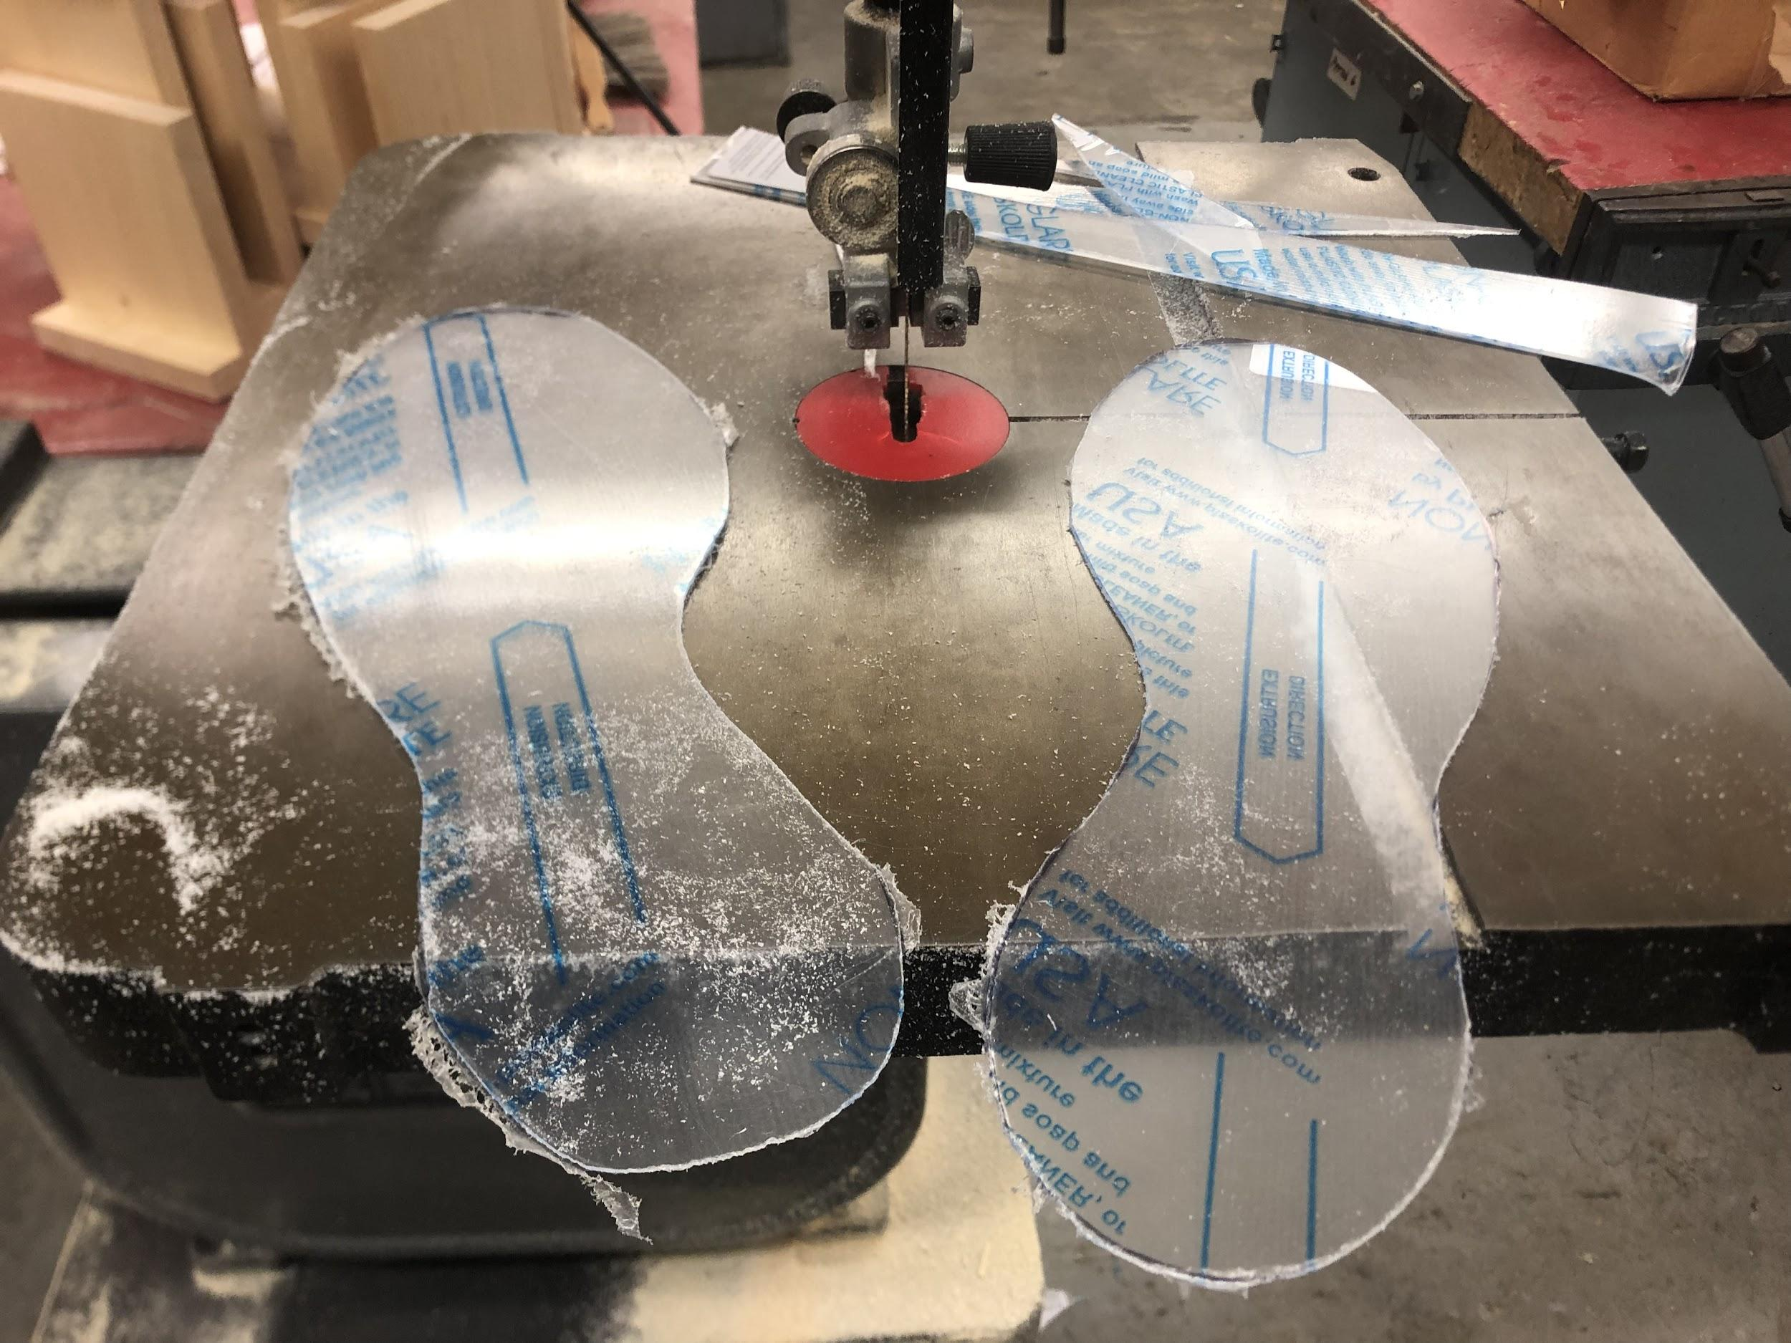
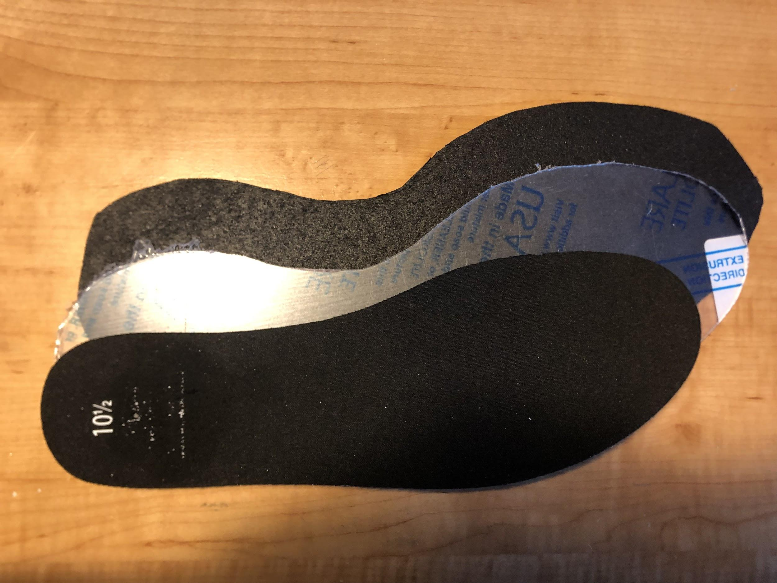
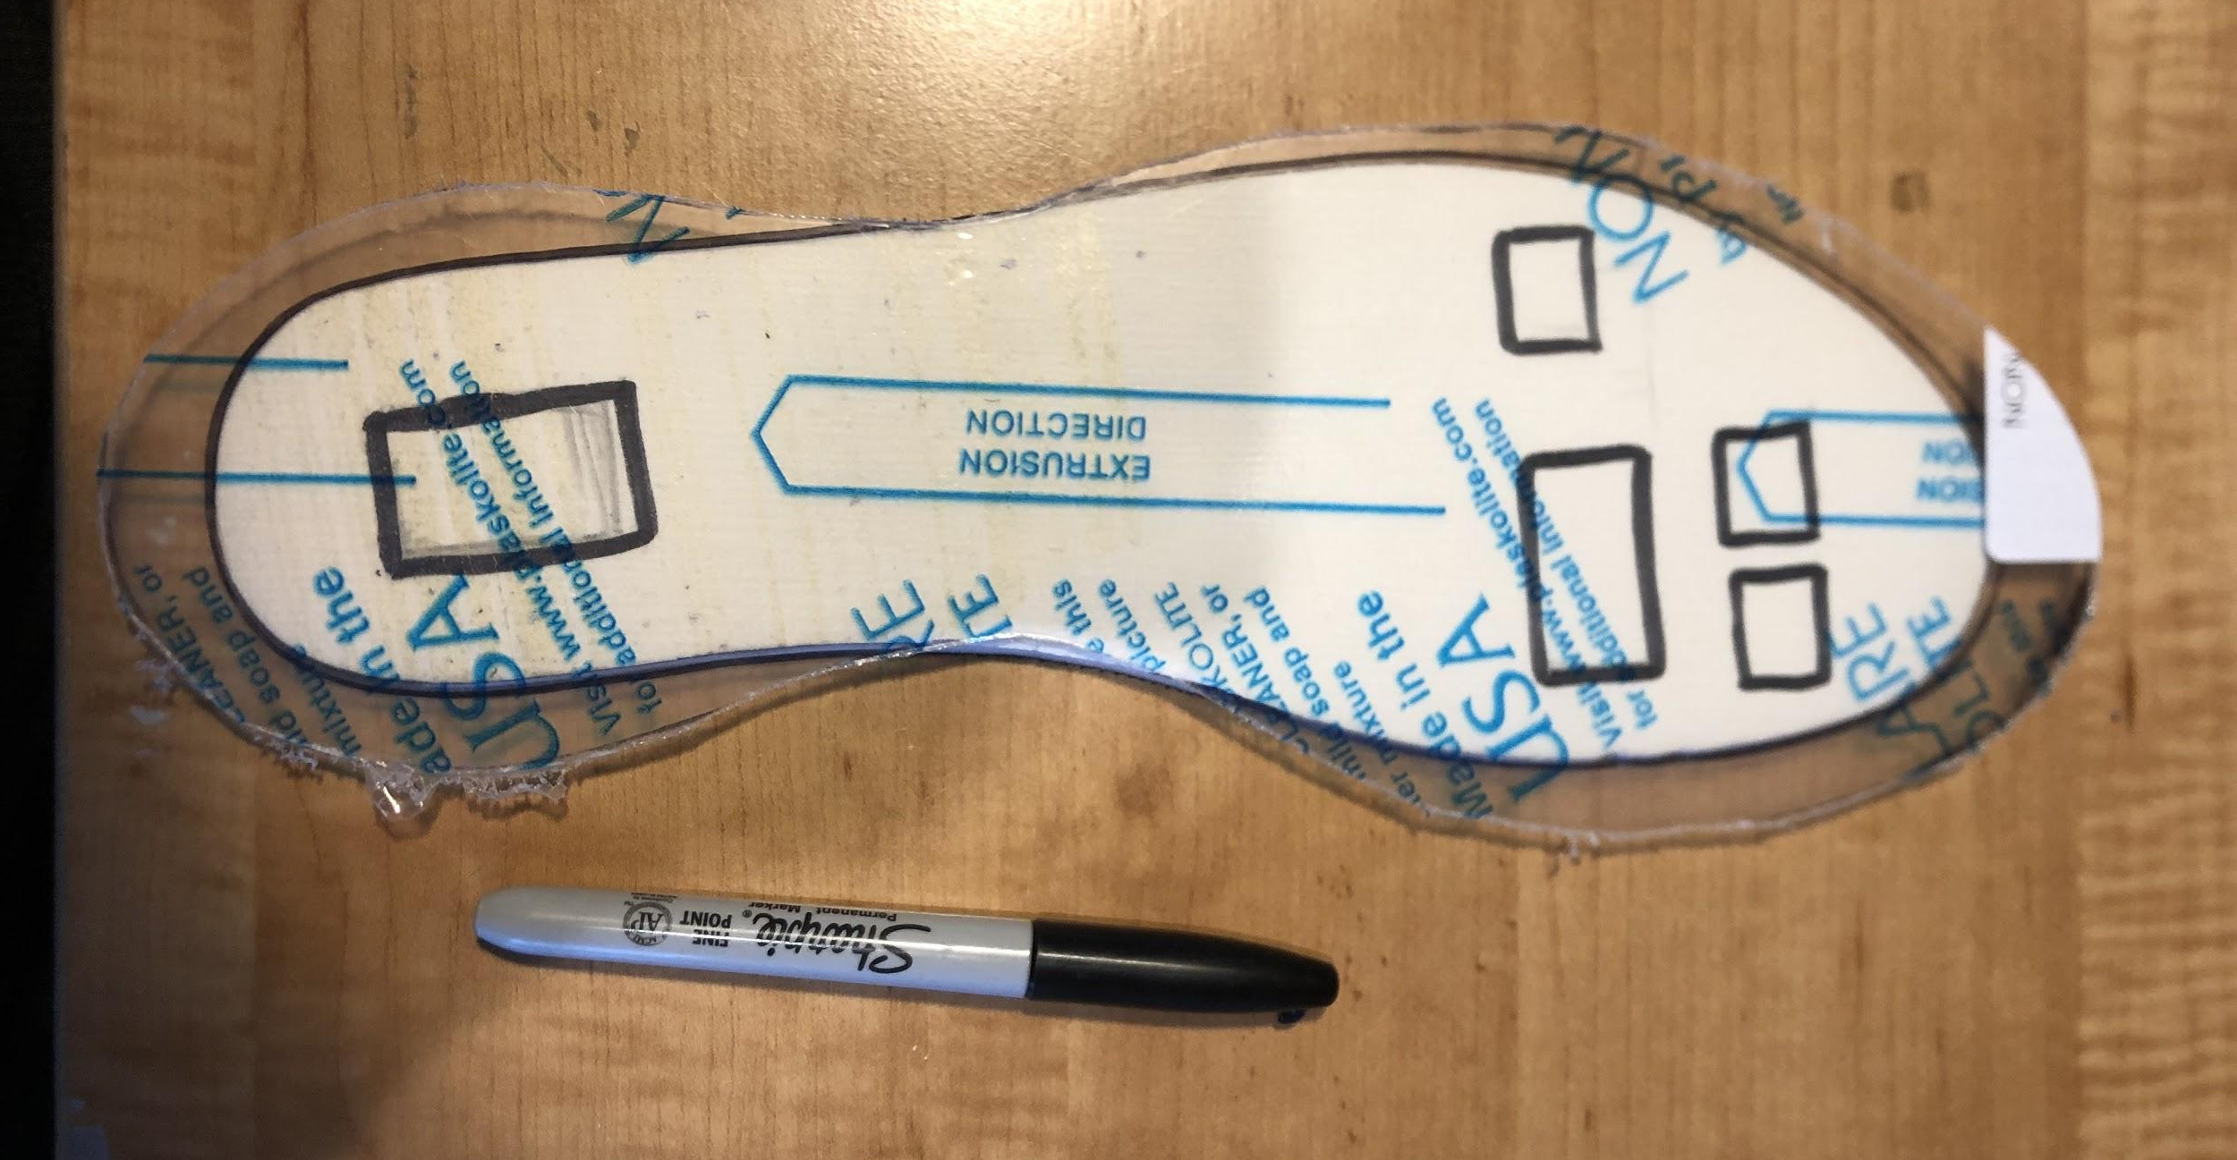
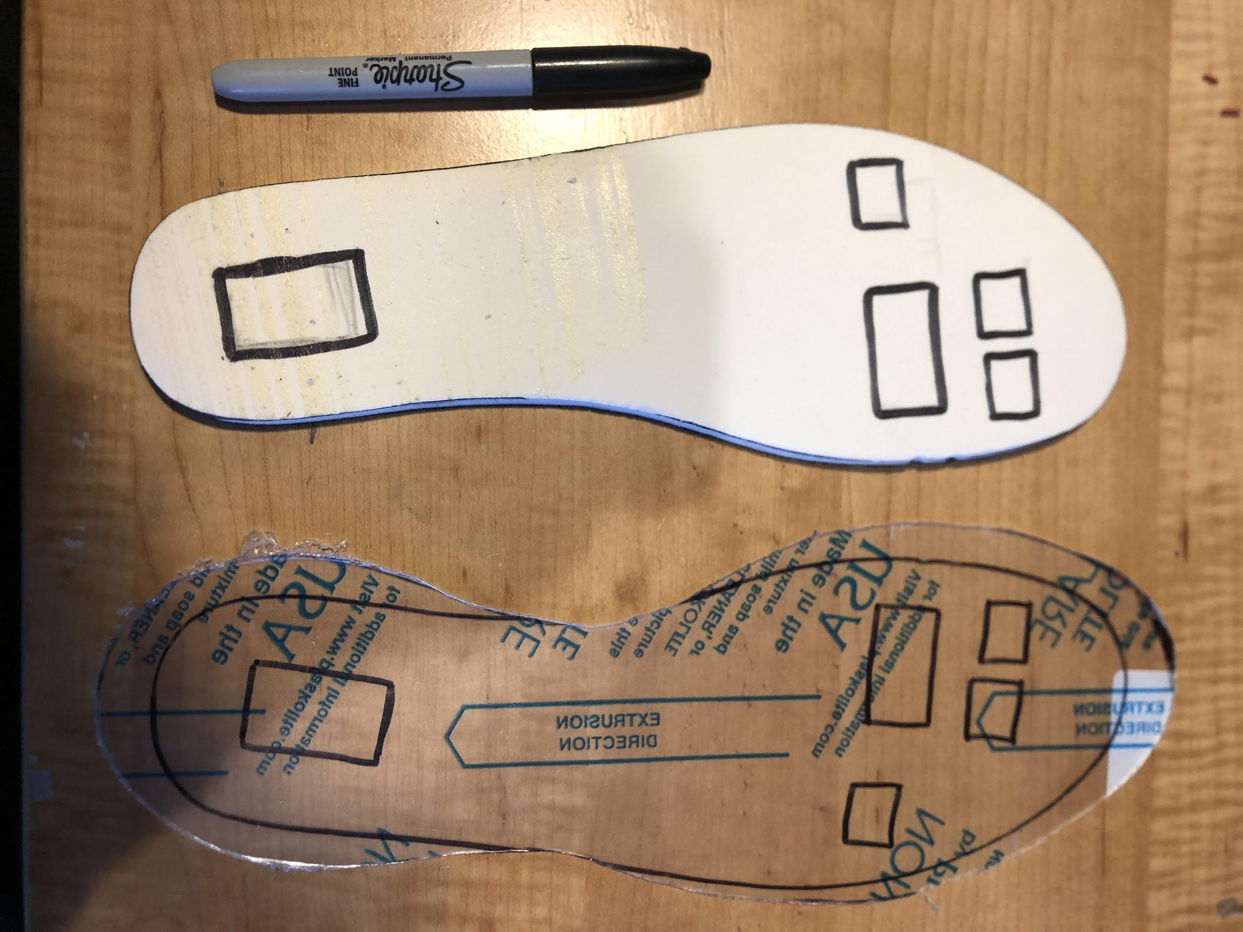
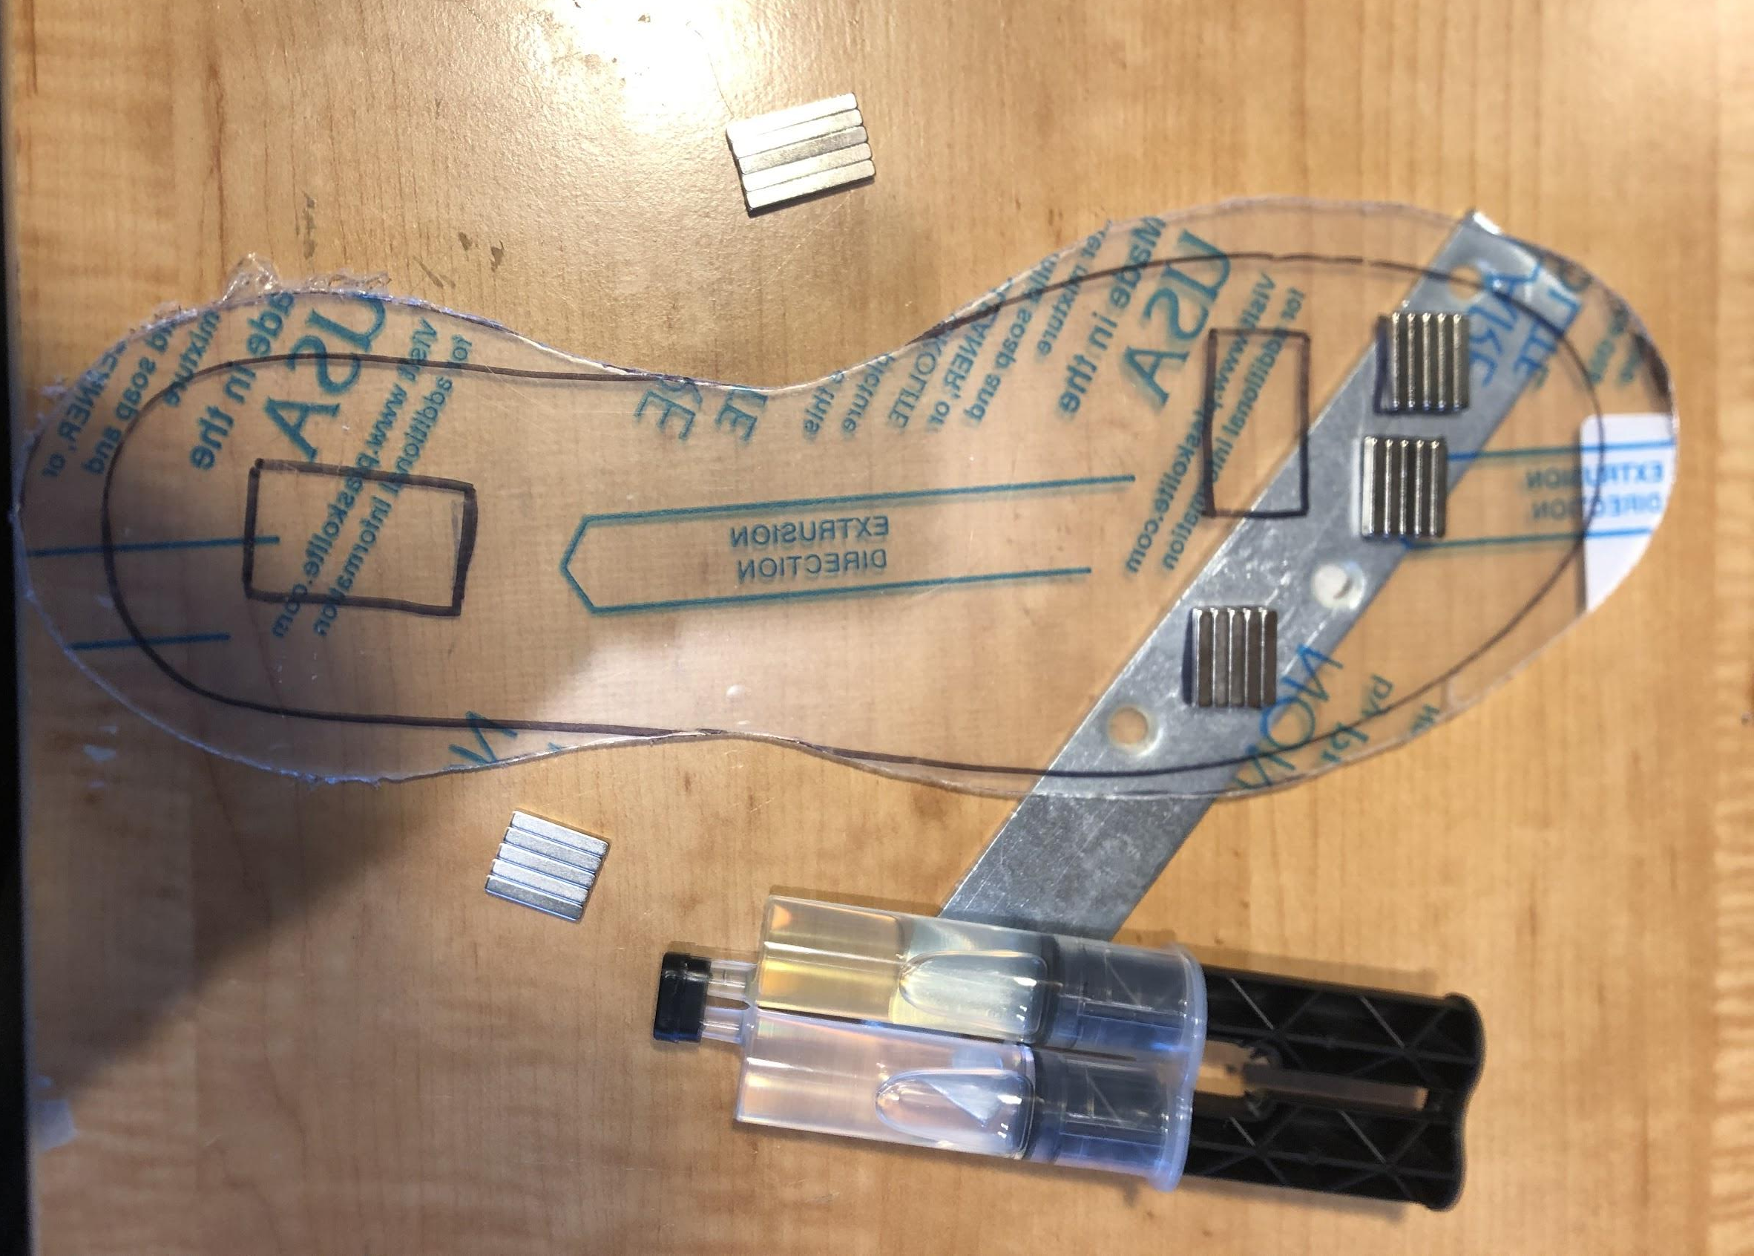
Figure 21: Step 1
Figure 22: Step 1 - 3 Parts of the Sole
Figure 23: Step 2
Figure 24: Step 3
Figure 25: Step 3 Result
Figure 26: Step 6

Slide 21
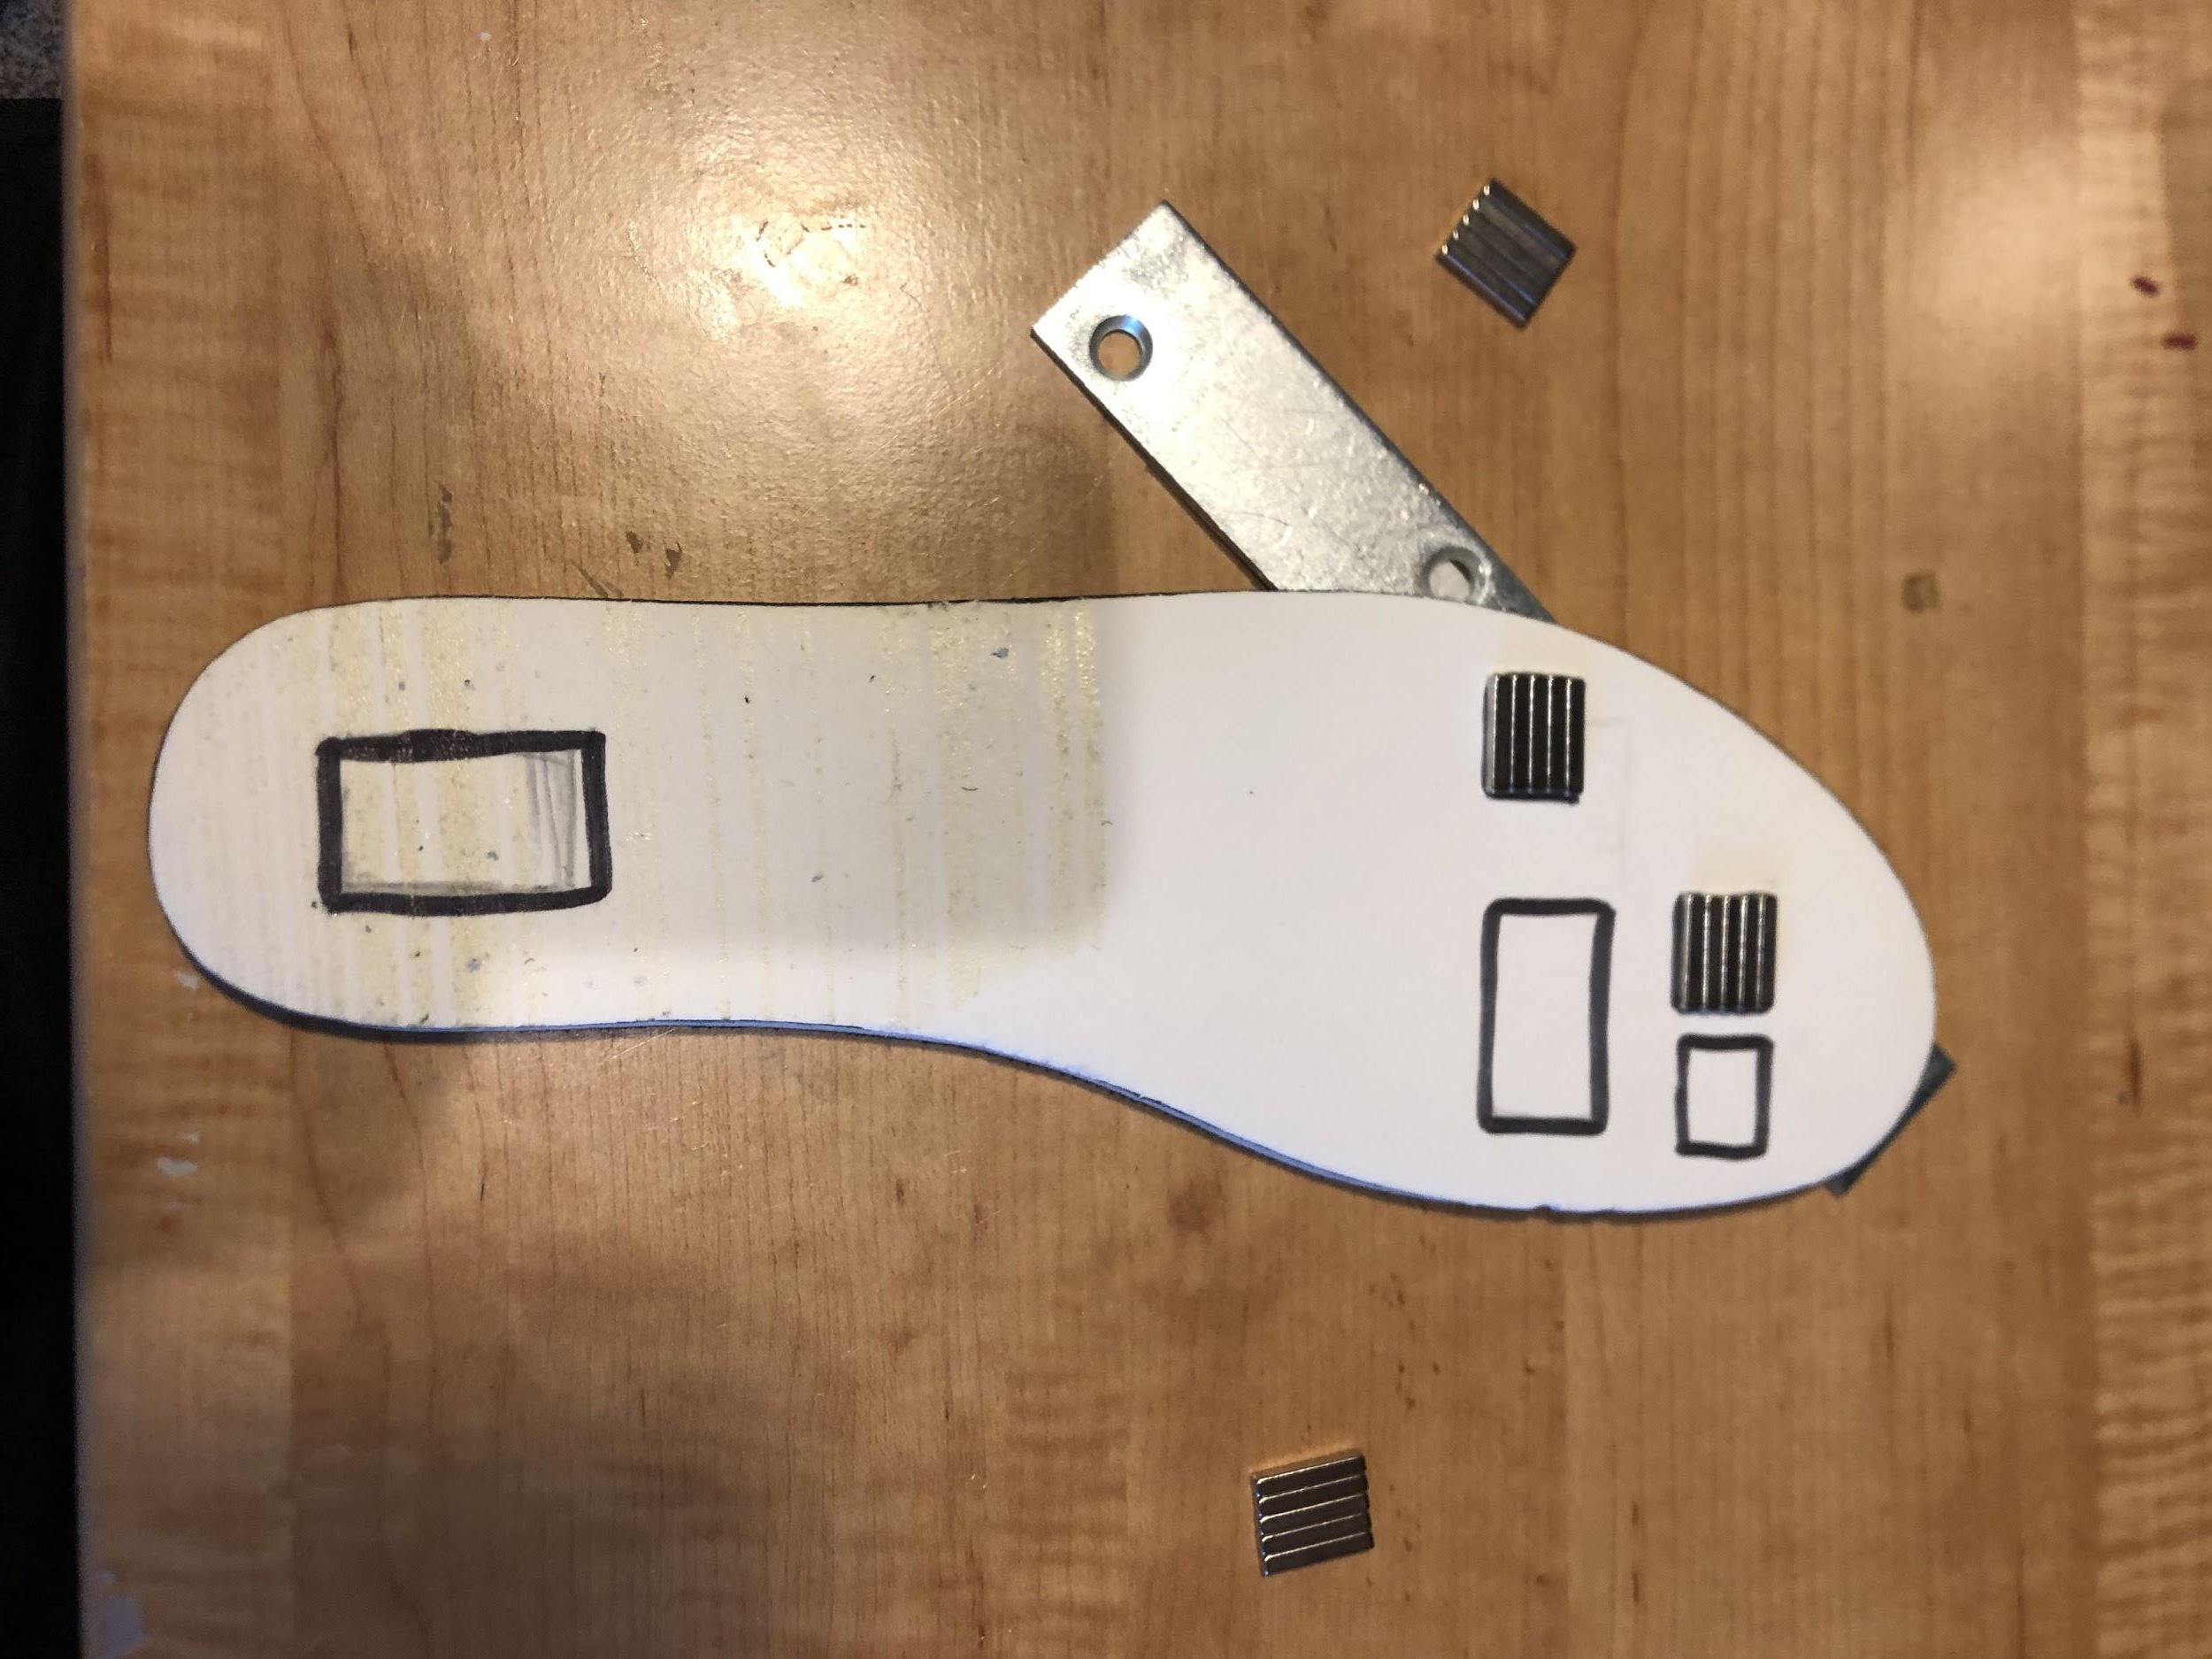
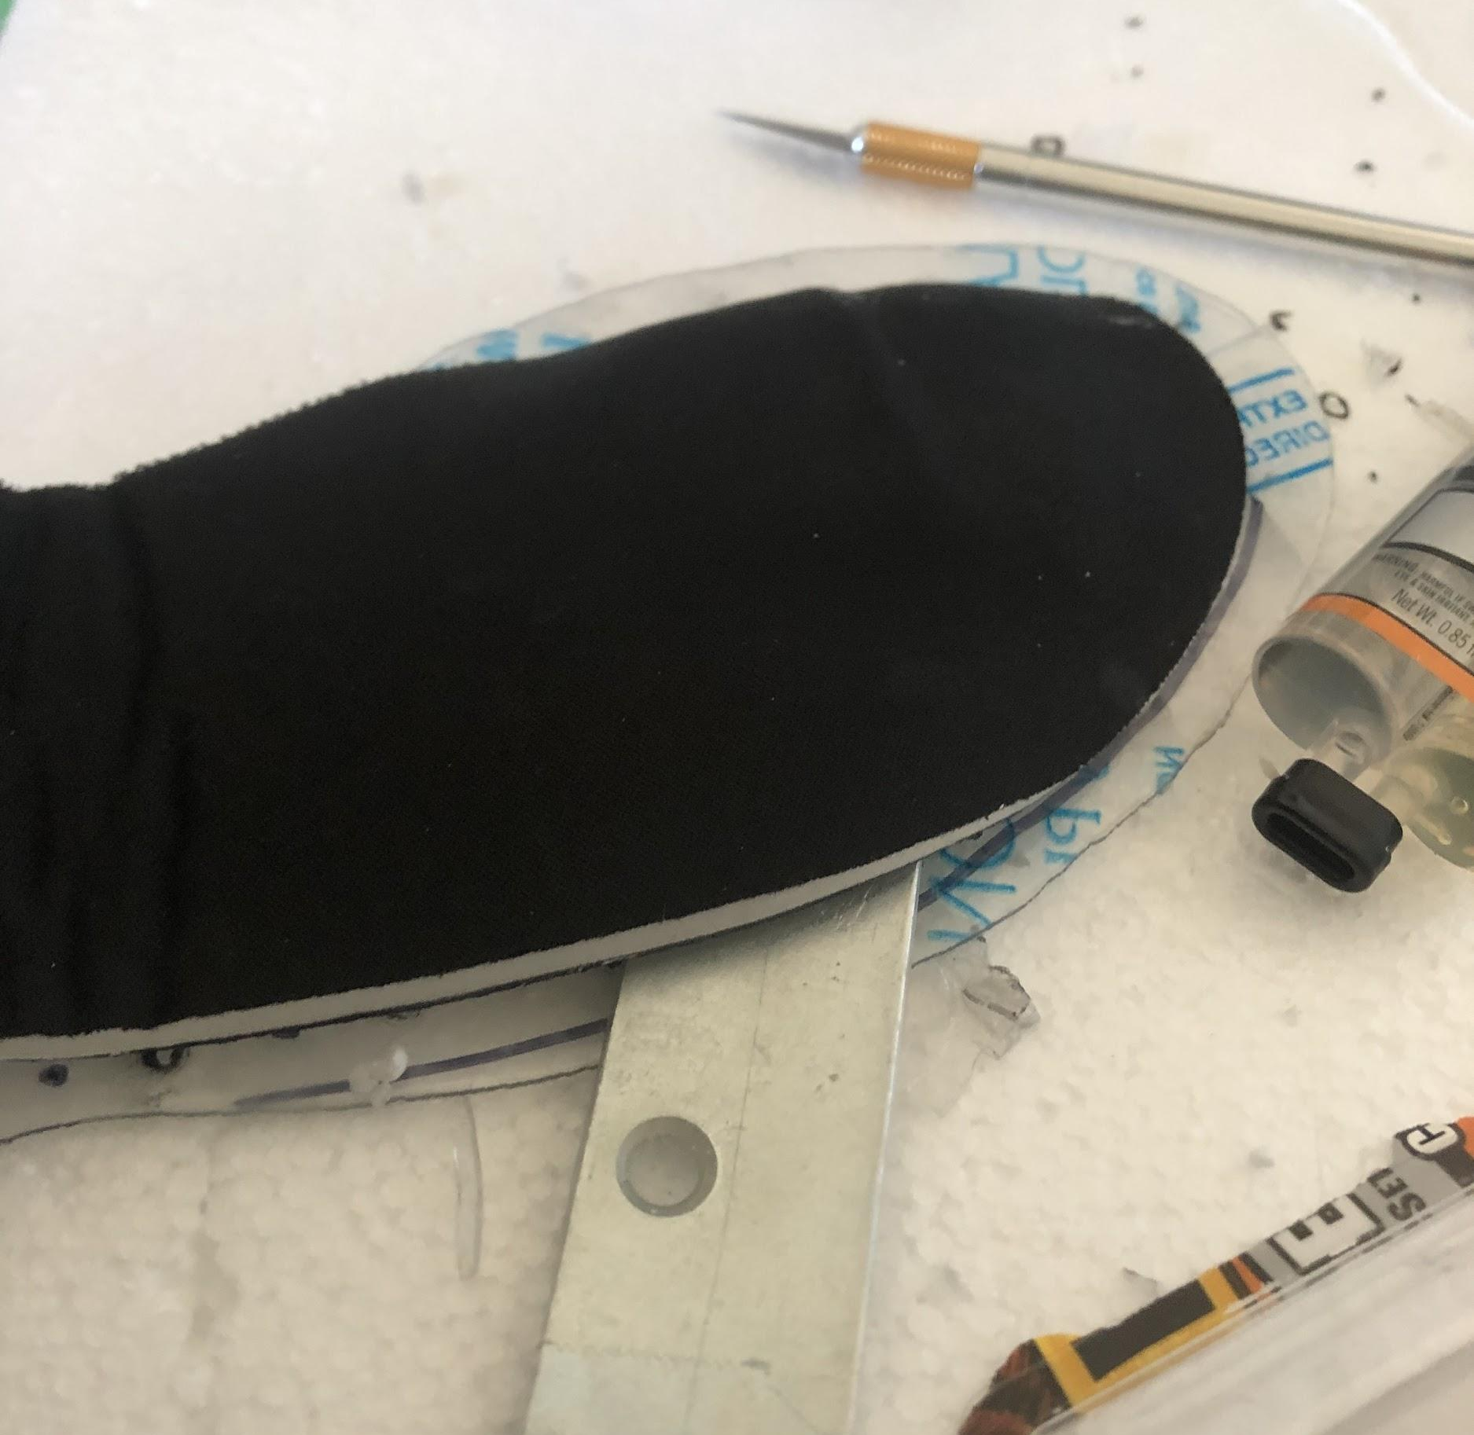
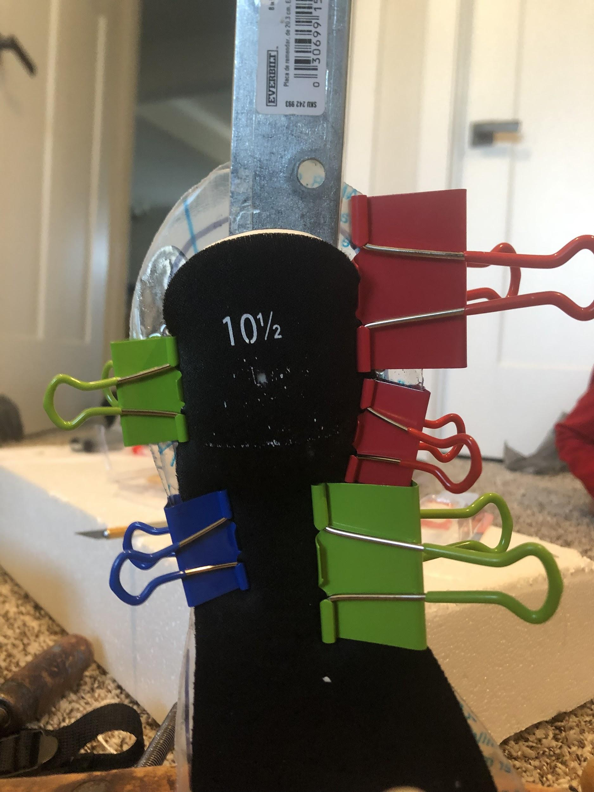
Figure 27: Steps 4 and 5
Figure 28: Steps 7 and 8
Figure 29: Steps 9 and 10
Figure 30: Cross Section of Prototype Z

Slide 22
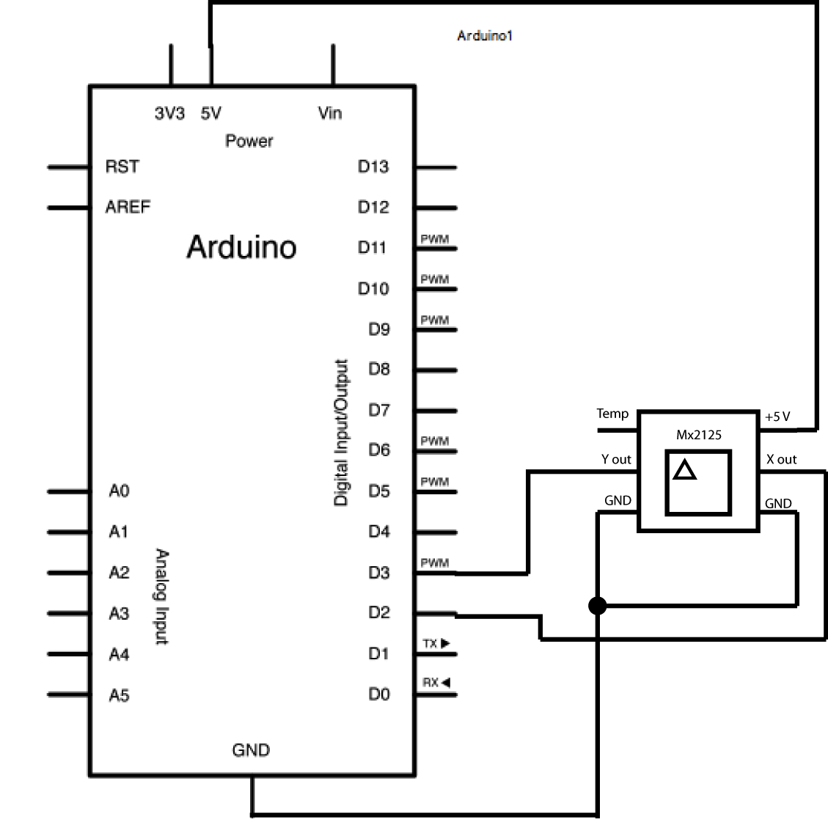
Arduino Accelerometer
const int xP = 11; const int yP = 12; void setup() { // put your setup code here, to run once: Serial.begin(9600); pinMode(xP, INPUT); pinMode(yP, INPUT); } void loop() { // put your main code here, to run repeatedly: int px, py; int ax, ay; px = pulseIn(xP, HIGH); py = pulseIn(yP, HIGH); ax = ((px / 10) - 500) * 8; ay = ((py / 10) - 500) * 8; Serial.print(ax); Serial.print("\t"); Serial.print(ay); Serial.println(); delay(100); }
Mx2125 Accelerometer
https://www.arduino.cc/en/tutorial/memsic2125
Figure 31: The wiring diagram for the Arduino and accelerometer

Slide 23
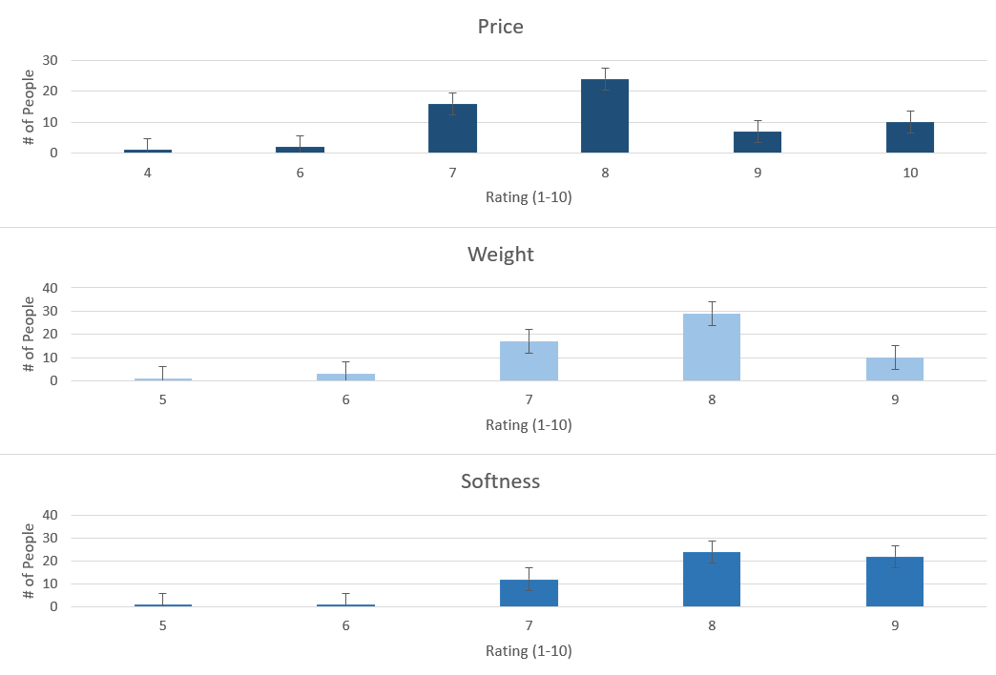
Human Testing Results
60 male participants age 60+ with roughly size 10 feet were asked to walk 5 meters
They were then asked to rate (1-10) on 3 criteria using their experience and information provided
How soft are these compared to your current shoes?
How light are these compared to your current shoes?
How cheap are these compared to your current shoes?

Slide 24
Analysis
This year’s shoe surpassed last year’s shoe under both test conditions: deceleration testing and human trials. The mean deceleration during walking for last year’s shoe was greatly enhanced by approximately 19% by this year’s shoe. A similar trend can be seen when looking at the running data. The standard deviation for both types of testing were very low due to the precision of the testing methods applied, as well as the accuracy of the accelerometer used. The standard deviation for the running, though, was double that of the walking trials. This could be due to the slightly less spread out and less controllable nature of running gait forces.
So why is this important?
The 19% efficiency directly correlates to the impact of the Ground Reaction Force on the joints and leg muscles helping the walking and running ability when a shoe is enhanced with simple Maglev using static magnets. The results showed a significant improvement to the Great Toe, Central Metatarsals, Heel, Medial Metatarsals, and Lesser Toe due to the reduced deceleration in Prototype Z shoe, thus helping with joint and muscle pains like Plantar Fasciitis.
An ANOVA Test was conducted to determine the significance of the data. The p value’s small size (Walking: 7.43E-126) (Running: 9.70E-105) shows that not only is the data significant and that this year’s shoe is better than last year’s shoe.

Slide 25
Discussion
The modified shoe surpassed the unmodified shoe, as well as the shoe with memory foam, in the conditions tested. The average rate of deceleration for last year’s shoe at walking speed was 6.23 m/s^2. The average change in deceleration for the modified shoe was 5.08 m/s^2. This data, along with the data collected from prior prototypes, the running data, and the human testing performed shows that this project was a complete success, as it is stayed under the $20 budget, was far softer than last year’s shoe, as shown by the deceleration testing, was 204.3 g (below the constraint), and remained equally as flexible as the last year’s shoe because the magnets didn’t interfere with any part of the shoe that was responsible for flexibility and the polycarbonate is very durable. It is very practical mainly because, unlike last year’s shoe, it can adapt with more force and it’s extremely thin, making it better suited to provide more comfort. In addition to that, it is light and cheap and is surprisingly easy and simple to understand, despite the complex concepts behind it. This year’s shoe was 19% softer, .5% underweight, and 35% under budget. The intent of this project was to redesign the shoe and find a solution for those people how have foot problems, and hopefully this project will provide new hope for those living in pain.

Slide 26
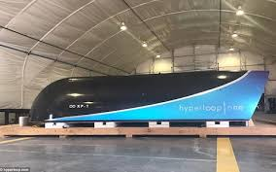
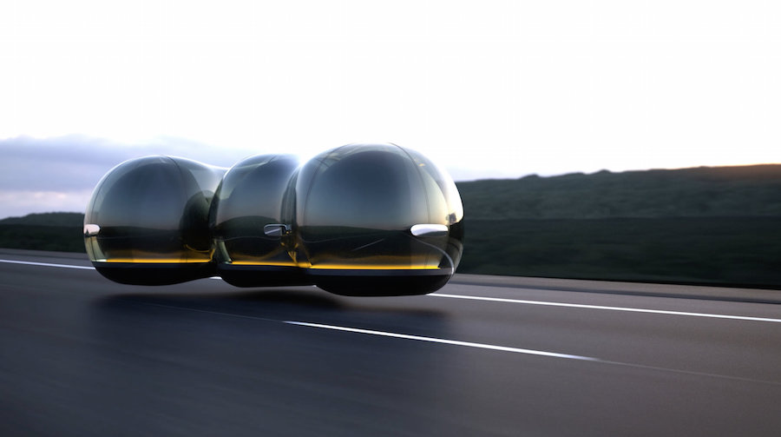
Future Ideas
http://www.telegraph.co.uk/technology/0/hyperloop-will-future-transport/
Figure 45: The Hyperloop One project, which uses Magnetic Levitation to provide rapid transport
https://www.thelondoneconomic.com/tech-auto/future-will-driving-around-cars-float-thanks-magnetic-levitation/21/09/
Figure 45: Concept Design of Magnetic Levitation based transportation
Develop In-Shoe Hardware for extra Gait data
By collecting data by using piezoelectric pads and a bluetooth-based Arduino to transmit data. This dataset can be used to develop a Machine Learning based app for finding the right shoes and analyzing gait to develop the best shoe possible.
Find a better way to join the insole and polycarbonate together
The two pieces are currently joined together with epoxy, which is one of the strongest adhesives you can find in the market these days. I want to find something even stronger like possibly stitching with nylon cord.
Apply this same technology to other areas that require greater cushioning
Football helmets could be a great example of an area requiring redesigning due to the amount of head injuries that occur from the lack of sufficient cushioning
And Improvements on Possible Errors

Slide 27
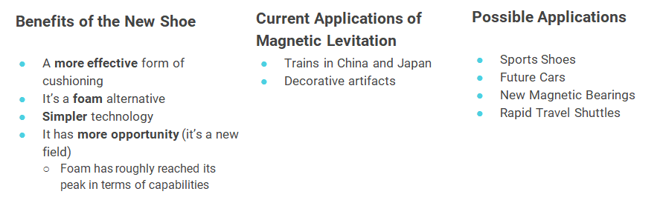
Applications & Benefits of the Redesigned Shoe
Halbach Arrays give more power with the same size, weight, and cost
http://www.telegraph.co.uk/technology/0/hyperloop-will-future-transport/
https://www.thelondoneconomic.com/tech-auto/future-will-driving-around-cars-float-thanks-magnetic-levitation/21/09/
Figure 32: The Hyperloop One project, which uses Magnetic Levitation to provide rapid transport
Figure 33: Concept Design of Magnetic Levitation based transportation

Slide 28
Previous Year Summary
The main focus of the previous year’s work was to show a proof of concept for the idea that magnetic levitation could be implemented into a shoe to reduce ground reaction forces. The shoe was developed through 4 different prototypes and several methods of testing and a lot of work was done around finding the optimal placement for the magnets based on gait (walking) data collected in other studies. Using this gait data, as well research done around the current technology, pedobarohgraphy, and human anatomy, a shoe pattern was found that provided optimal cushioning to each part of the foot in accordance to the foot pressure at that spot. Then this pattern was implemented into several prototypes and used to produce one final shoe that used magnetic levitation to successfully reduce ground reaction forces.
Overall, the shoe met all the constraints, although only creating a basic shoe with several areas in need of refinement. The shoe itself was very light and excellent in that measure, but the shoe was thick and could be reduced to create a cleaner and more magnet-oriented shoe that focused on supporting the magnetic levitation as opposed to supporting an unnecessary foam structure. In addition to tha, the force provided by the original magnets created a large impact but this could definitely be improved greatly. Increasing the force would make the shoe incredibly comfortable, but the problem constraining the force was the matter of weight, which would increase as more magnets would be added for more force. Lastly, testing had 9 trials last year, which was below satisfactory. More testing would help verify the practicality and real world applicability of the shoe.

Slide 29
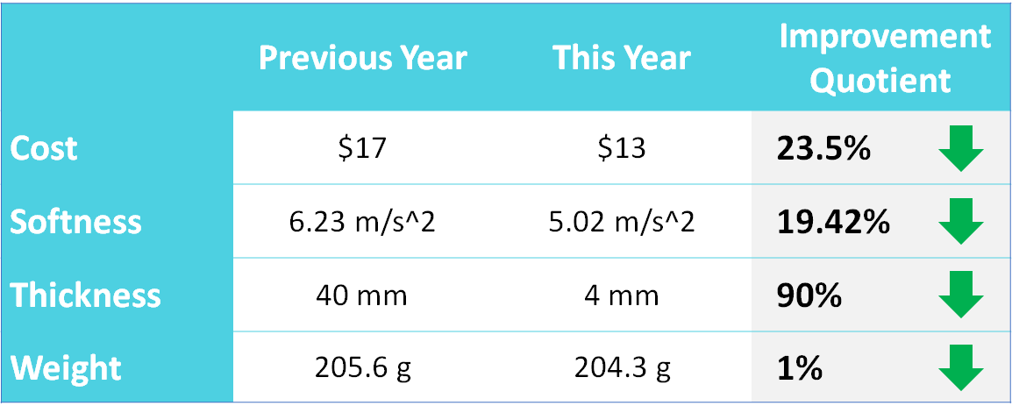
Optimization Statistics

Slide 30
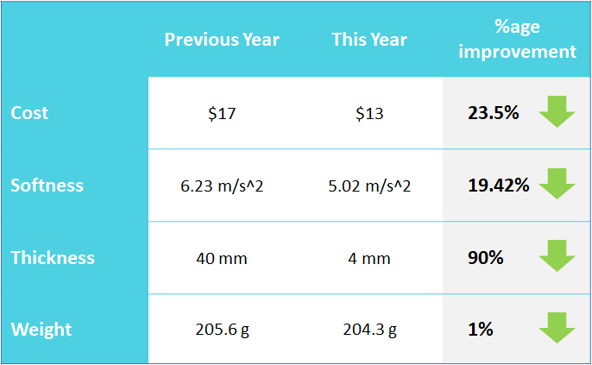
Highlights
Difference in Constraints from Year 1 to Year 2

